Slide 1
SEN Pathway
<your school> Schools

Slide 2
SEN CODE OF PRACTICE
The SEND Code of Practice:
Extends its age range to cover children and young people from 0-25
Includes children and young people with disabilities as well those with SEN
Focuses on the views of children and young people and their parents
Focuses on high aspirations and improving outcomes
Emphasises the importance of integration between different agencies
SEN support has replaced School Action (SA) and School Action Plus (SA+) and statements are now Education, health care (EHC) plans

Slide 3
Identifying and teaching pupils with SEN
‘Every teacher is responsible for every pupil’
Every teacher is responsible for the progress and development of every pupil in their class. This includes pupils who access extra support from teaching assistants or specialist staff.
The first step in supporting all pupils, including those with SEN, is high-quality teaching, differentiated for individual pupils.
Some pupils may need additional help to access the curriculum or make expected progress. These pupils may have SEN.

Slide 4
Not every pupil making slower progress has SEN
Some pupils may make slower progress for a reason unrelated to SEN, such as a gap in their learning.
You should regularly assess the progress of all pupils and work with the SENDCO to identify whether a pupil has SEN.
You should ask whether the pupil’s progress is:
Significantly slower than that of their peers starting from the same baseline
Failing to match or better the pupil’s previous rate of progress
Failing to close the attainment gap between the pupil and their classmates
Widening the attainment gap

Slide 5
The role of the SENDCO
The SENDCO will support you in delivering SEN provision, but their role is largely a strategic one.
They are not responsible for teaching pupils with SEN, or for deciding on specific teaching strategies for pupils with SEN, though they will offer you advice on how to do these things, including selecting which advices from outside agencies to implement within our school environment.

Slide 6
Implementing support for pupils with SEN
Categories of need:
The needs of pupils with SEN usually fall into one of the following categories:
Communication and interaction
Cognition and learning
Social, emotional and mental health
Sensory and/or physical
If a pupil has SEN, they will most likely receive ‘SEN support’. This support may lead to the application of a EHC.

Slide 7
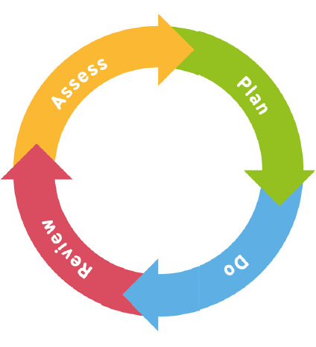
The graduated approach
Assess: the class teacher and SENCO should analyse a pupil’s needs before identifying them as needing SEN support
Plan: the class teacher and SENCO should agree the support to be put in place.
Parents must also be notified and consulted and an IEP is created
Review: the class teacher and SENCO should review the effectiveness of the support regularly and agree any changes where needed.
Do: the class teacher remains responsible for working with the pupil on a daily basis with additional intervention if needed. High quality differentiation is still needed in the classroom
You should also involve parents in this process and meet to review their child’s progress at least three times per year.

Slide 8
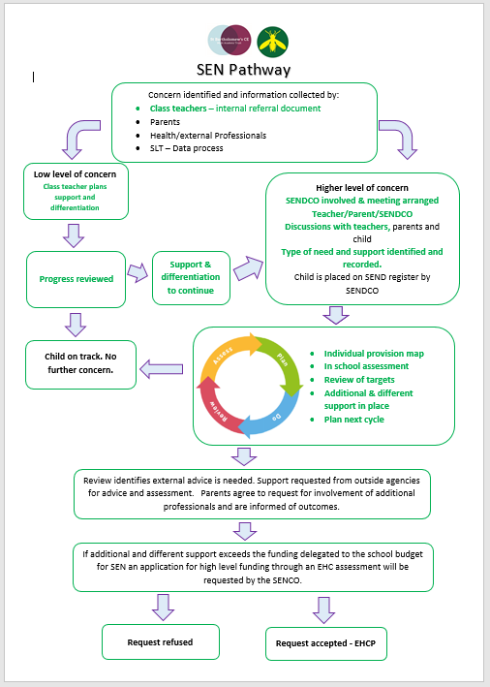
Back

Slide 9
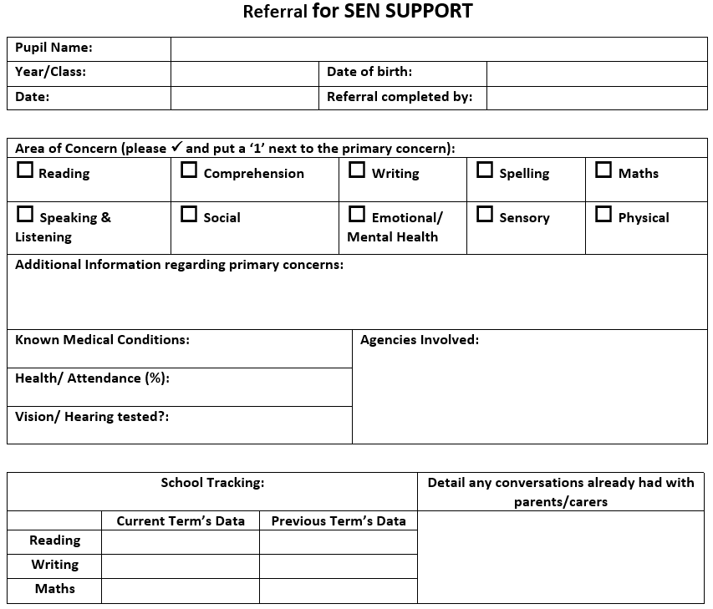
Back
Outside agencies look for two cycles

