Slide 1
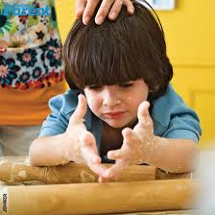
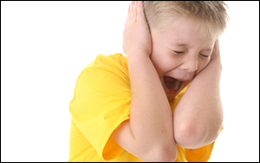
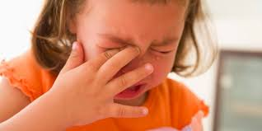
Sensory Processing Disorder
https://www.youtube.com/watch?v=K2P4Ed6G3gw
What is it and why are we looking at this?
We have an increase children who are coming to school now with sensory processing disorder. Some of them have quite complex processing issues that affect their ability to learn and concentrate.
https://www.smartkidswithld.org
Todaysparent.com
Themighty.com
Notes:
Scott mahoy 16th Jan 2015. Staff to watch this clip, as part of CPD, on you tube to actually visualise what sensory overload looks and sounds like .
According to Webmd.com Sensory processing disorder is: “a condition in which the brain has trouble receiving and responding to information that comes in through the senses.”
Benne ( 2016) wrote a blog for the autism awareness centre and writes that for a long time sensory processing disorder was associated with autism . She writes that it is only in the last few years that SPD is now seen as a “ stand alone disorder, and that children can have SPD and not autism and vice versa”
she also states in her blog that “SPD can even evoke irregular responses that can cause health issues like not registering temperature in a typical way that allows the individual to dress appropriately for health and safety’s sake.”
Horwood ( 2008) states “ A child's reactions are often automatic responses to sensations which their brain cannot tolerate, be they noisy, messy play, bright lights or the inability to take their feet off the ground when stepping onto a bench without feeling disorientated” ( p 4)
She then go's on to further say “ we take it for granted that once a child can sit , stand and walk they have appropriate level of sensory motor development to function in a school setting……giving little consideration to this when planning the daily timetable.” (p 4) This is certainly true in a Secondary setting , when students arrive in year 7 there is an assumption that that they are secondary ready physically as well as cognitively.

Slide 2
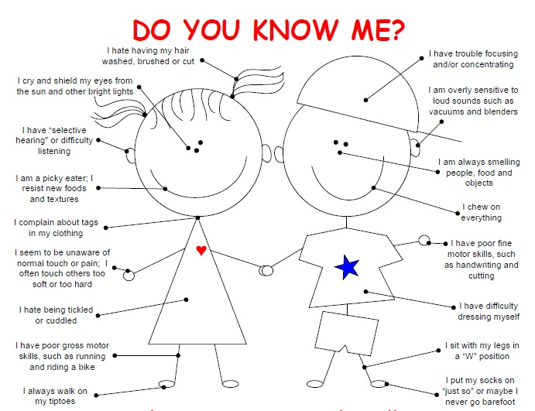
Sensory symptoms reported by Parents
By Michelle Critelli, OTR/L
https://www.firstchildrenservices.com/do-you-know-me-common-sensory-processing-disorder-symptoms-that-are-easy-to-overlook/
Notes:
Information on the ‘child mind institute web page’ in relation to sensory processing shows that parents of sensory children will first recognise symptoms whilst the child is a toddler. It is likely that the child will struggle with noise , lights and even have problems with shoes and different types of clothing. In addition to this the child is likely to be clumsy and may have fine motor skill difficulties.
The diagram on the slide represents some of the signs parents or teachers may see in young children

Slide 3
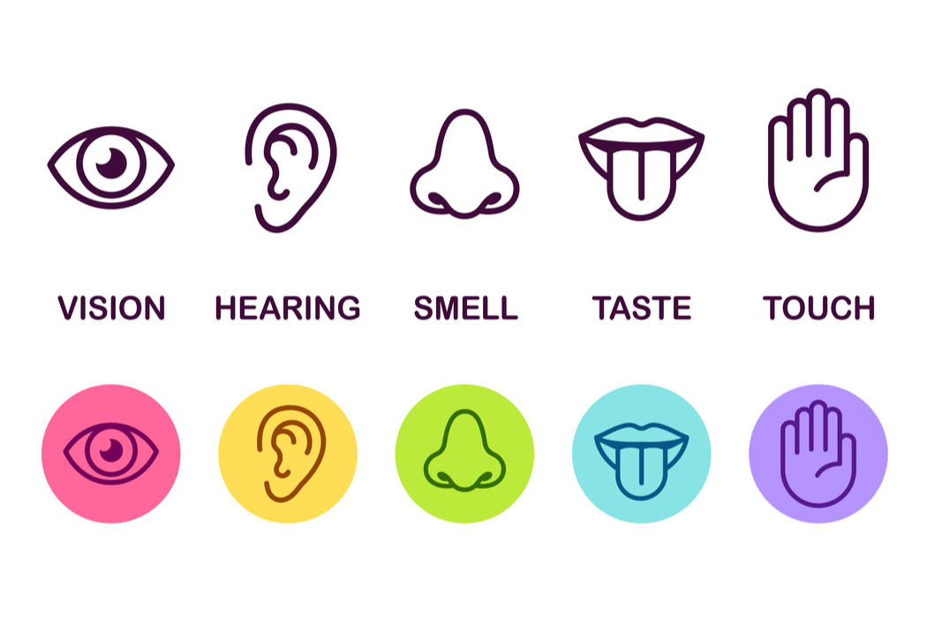
Most of us are familiar with the 5 basic senses
Image from worldatlas.com
Notes:
Some people have sensory issues in one of these five areas , for example they do not like to be touched by other people or find wearing certain clothes difficult .
Some people struggle with taste or have difficulties with textures of food .
Others are hypersensitive to smell and strong smells can lead to them feeling physically sick.
Some of us struggle with bright lights and need less visual input . For some a loud noise can be enough to make them place their hands over their ears.

Slide 4
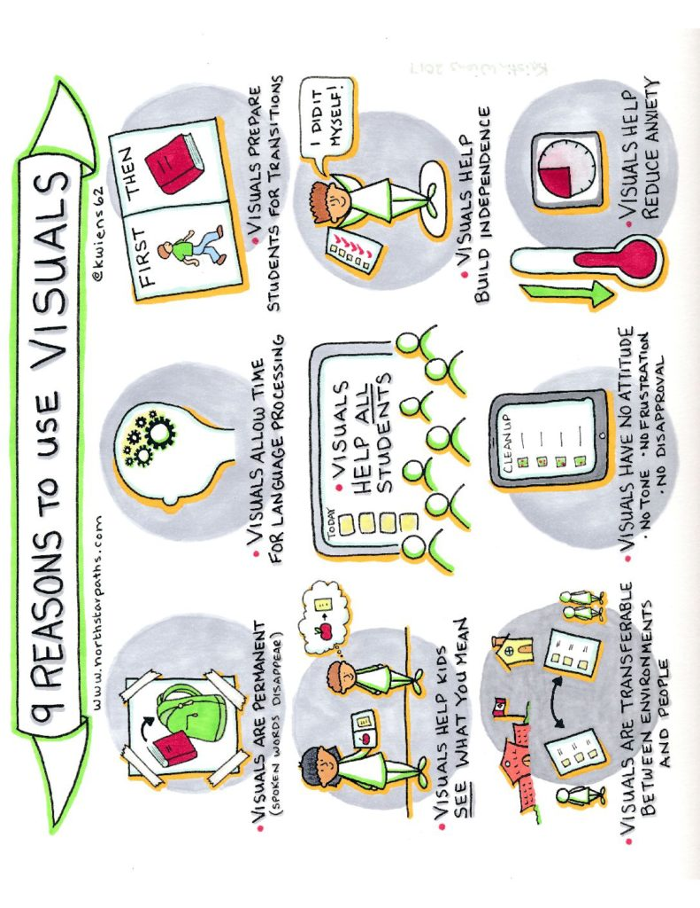
www.northstar.pathscom
Notes:
Staff will notice that strategies have been provided in student individual learning plans. These have been written by the school SEN Team over the last few months. Some strategies refer to the following : ‘Joe Bloggs will need visuals to support verbal instructions’. Many of our students have memory processing issues , whether this be short term or working memory . Using visuals to support children will make them feel more in control of their learning because when they see something they can hold it in their brain and use this along side the verbal instructions. Visuals also help break down information into chunks. ( see appendix 1 and 2 for teacher handouts)
Susan Daniels recently wrote a blog ( 2019) titled ‘Why Visual learning and Teaching’. The blog was written after she published a successful book ‘Visual Learning and Teaching ‘
Daniels ( 2019) wrote in her blog ; “By introducing meaningful visual elements to the curriculum, educators can help students more completely engage the multitude of visual messages they receive daily.” the teachers that she has worked with report that “ students, consistently report better student scores on quizzes and tests as well as stronger essays projects, and papers”.
So why is this the case ? Why are visuals so important ,not just to those who have sensory processing issues, but to all students ?
Daniels (2019) suggests that we live in a much more visual world. Children have more access to lap tops, smart phone and I pads, all of which provide us with visual stimulation in various forms. She writes in her blog “it becomes paramount to proactively teach students to “read” and create visual texts”
Daniels (2019) has created the ‘ Visual triad model ‘ she believes that visuals support students to develop literacy in the following ways :
Decode – to understand and translate communications made with visual imagery
Imagine – to create, interpret, and manipulate mental models of imagery
Encode – external images that we create
This is particularly important for students at present, especially as GCSE examinations have taken on elements of A levels examinations which means new concepts and language has had to be filtered down to students in earlier years of secondary school.
Daniels continues her blog by looking at how students are able to analyse and interpret better when they are presented with graphs and charts that allow them to discuss what may be inaccurate and for them to predict what may happen next. The same would be true in maths when students are presented with visual cubes or pieces of lego , rather than just seeing number on a page.
As teachers we must be aware that ;
“On their own, verbal instructions on the whiteboard are not an example of visual language or communication. Visual learning begins when simple yet meaningful doodles or depictions are added alongside the verbal instructions. It continues when text and visual elements appear together in the form of a graph or other diagram or an illustrated text such as a picture book or graphic novel” https://www.insightresources.org/2019/04/26/why-visual-learning-and-teaching/

Slide 5
However what we don’t think about is sense number 6
Subtleyoga.com
Notes:
Proprioceptive system
Horwood (2008) suggest that we have receptors that are called proprioceptors, they are found in the muscles, joints and connective tissues. “ They provide the brain with information related to the position of limbs the position of the body in space and the contraction and stretch of muscles, and the force and effort required within an activity. “ Ultimately this is relates to the bodies sense of awareness – where we are in the space and how much effort it takes our muscles to make our body move. EG when you reach up to get a something from a cupboard this system tells your body how much effort is needed to reach and not drop the item. This sense lets us fit into the environment we are in.
If we consider the school day , the transitions on the corridors , moving up and down the stairs; the fact that most classrooms are different shapes and sizes and the teacher desks are in different positions ; as soon as child walks in they have to work out where they are in relation to the desks, the door, before they can settle in their seat.
This is why some children with sensory issues thunder up and down the stairs as they are trying to feel the step beneath them. ( Child A)
Some children need to feel the walls or tables as they walk past so they can feel the objects ( Child B)
Some children stride down the corridor using big movements with their arms because they don’t know how big they are or how much space they have (Child C)
Children with poor proprioception are often clumsy and will bang into things as they cant work out where they body is in comparison to an object. This has led me to question ; Are they better off being sat at the edges of the room so they can walk round to a chair , rather than navigating the desks in the middle ? Will this give a smoother start to the lesson for them if there is one less sensory issue? What else can we do to support them during the day ?
Horwood ( 2008) , states that “ input may accumulate ;the more we engage our bodies in heavy work through physical activity- including pushing, pulling, carrying, lifting, tugging and receiving deep pressure “ ( p 13)
This is clearly something that we need to add into daily activities for these children to help them self regulate during the day . This is why I plan to set up a sensory diet . It may be that we use it when a child needs a time out or it may be something we try and do once a day.

Slide 6
Proprioception activities
https://www.youtube.com/watch?v=Oquc160D1dw
Notes:
Sue Allan 2019 sensory Minis – you tube
Short video clips to give staff a visual of how we are affected by our proprioception system and exercises we can do.

Slide 7
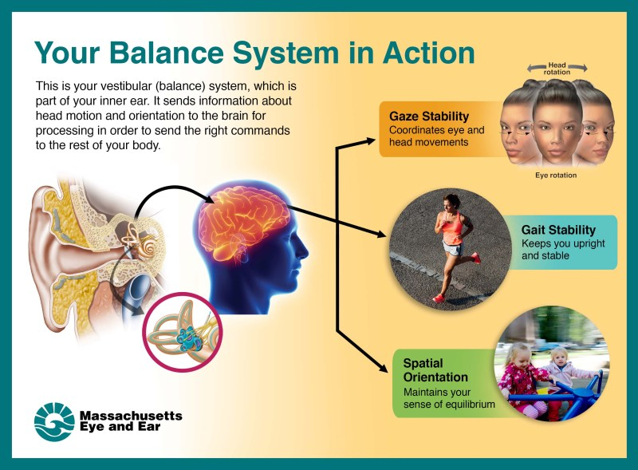
And sense Number 7
The Vestibular system
Infographic by Garyfallia Pagonis
Notes:
https://focus.masseyeandear.org/body-maintain-sense-balance/
This system detects movement and has senses in the inner ear. It also tells us where our head is in space .This system is key and works with the immune system to pull together all of the senses – it is like the junction box for the rest of the senses.
A clip produced by Aspergers central.com suggests “ The brain is overloaded it gets hammered by absolute traffic of input and its doing its best to sort and input the best it can” ( 2015)
For example you know you need to run if a car is coming but if this system does not work as well then the child cannot move quickly as the senses don’t work together.
A child with sensory processing disorder in more than one sensory area can often be over or under stimulated . For example Child B has a very low pain threshold and will cry over something we may think is unlikely to hurt. Wearing new shoes can be very difficult due to the feelings they create. Child B says that wearing particular types of materials can feel like she is being stabbed with pins. Aspergerscentral.com reports that “ they can feel like they are wearing sand paper instead of denim” (2015). If this is the case then it make it virtually impossible to concentrate on tasks at home or learning at school.
For some children this system is under regulated and they are not getting enough sensory input. Horwood ( 2008) says “ if we sit for long periods of time, there is minimal head movement and minimal vestibular stimulation , and ultimately we may find it more difficult to think, process and do (p14)
For example child A falls asleep in the morning – is this because he has been overstimulated coming to school with the noise and initial chaos of the bus and then moving around the building which means he is tired out or is it because the normal every day movements that he does in a lesson are not enough to stimulate him. To wake him up he appears to need to whirl around like a helicopter at break time to create big movements for this system to actually carry on the rest of the day.
Working alongside a local occupational therapist I am planning to put together sensory diets to help some of our students self regulate. They will carry out specific activities recommended to us and those from my own research . Having a background in PE and having previously done a diploma in Speed Agility and Quickness for SEN, I have access to specific equipment from PE and can see how some of the equipment we use in PE can be used in a totally different way to support children with sensory issues.

Slide 8
Vestibular Activities
https://www.youtube.com/watch?v=ueDQjhJDqIg
Notes:
Sensory Mini’s Sue Allen and Anthea Thornton animated by Eva stanistreet
Short video clips to give staff a visual of how we are affected by our vestibular system and exercises we can do.

Slide 9



Hyper sensory or under responsive
Colours may be seem brighter
Pictures and writing could be distorted
Cluttered walls and desks will distract them
Difficulty tracking when reading
Struggle with noise, may pick up noise from lights or crinkling plastic.
Get lost with long explanations
Not aware of own voice volume
Some smells could become overpowering and lead to child feeling sick
EG perfume
Deodorant
Body odour
Smelly feet
May be a picky eater
Struggle with textures
Detect particular tastes and not want to eat it.
Light touch can give a sensation of real pain
Struggle with the feeling of certain clothes they are itchy or cause pain
Might struggle with water on their face or clothes
Might not be able to tolerate dirt
Low pain threshold
Will often be clumsy.
Don’t enjoy change of direction and can often feel dizzy
May not ride a bike
Car sick
Discomfort sitting for long periods
Struggle to remain balanced so fidget and may become off task
Notes:
Staff may be able to visualise students ,that show signs of having hyper sensory needs . For example child B, C, D and E are clearly under responsive. They become very anxious in loud situations , become overwhelmed if too many people come into the classroom , especially new visitors. All have some issues related to clothing and child E cannot tolerate rain water on clothes and in hair an child C will not wear a coat even if it is snowing !
To further research SPD and to understand more about how a child can show under responsive senses , the following books have been key to my research :
Canavan ( 2015 ) Supporting pupils on the autism spectrum in primary schools , Routledge publishing
Canavan ( 2015 ) Supporting pupils on the autism spectrum in secondary schools , Routledge publishing
In the Secondary book , Canavan states, “ it is crucial to identify any sensory issues form the outset” ( p31) she also says that “ a mainstream school must be absolute hell for children who have sensory integration problems. There brain works harder to compensate for the difficulties they experience …… At the end of the day having held it all together at school, the child, may be utterly exhausted or overstimulated and go into shut down or melt down…..and the parents have to deal with the fall out” (p31)
What we also must remember is that “ bad behaviour may be a direct result of not being able to manage emotional responses to certain situations due to the poor connectivity in the brain and raised levels of chemicals” ( p 39)
Stimming is also something that we may observe in children with SPD . Stimming is the child's way of regulating them self or distracting themselves from the situation they are in . For example if the class is noisy they may hum to try and block out the noise or become noisy themselves, they may clear their throats, pull skin from fingers. Other forms of stimming occur through repeating a movement over and over again E.G flapping their hands , feeling a particular material E.G the corner of their blazer..
Canavan states that “stimming enables a pupil to concentrate on their work. if you insist that the pupil stops stimming you will undermine their ability to do a task”. (p 27 ) . This puts an strain on the child's already depleted executive functioning skills which may cause crisis to occur in school or at home. In a secondary setting this may affect the learning of others therefore we may need to see if there is something alternative we can give the child eg blu tac or a discrete fiddle toy. Some students doodle in a book while listening to the teacher .
Canavan offers several strategies for the different senses where children under respond ,these include:
Short instructions
Repetition of instructions
Writing down instructions and supporting them with visuals
Seating children away from the window
Using coloured overlays and cream paper
Writing on the board in different colours
Keep the table clutter free
Allow movement breaks

Slide 10
Hypo sensory or over responsive
Will struggle to track with their eyes and may need to feel things to gain visual support
Eg holding cubes in maths, seeing objects in art
They may be drawn to colour and light
Will seek noise
May be noisy themselves and very loud
Will bang around , walk up stairs noisily
Will try to find smells , they may sniff people or objects
They may not be aware of bad smells
Love strong flavoured food
May lick things to seek information
May over produce saliva
Very tactile and wants to touch and feel things
High pain threshold
Might chew or suck things
May struggle with clothes and get muddled g inside out or wrong way round
Strange walk , clumsy , fall over, cannot gage the amount of force is needed for something eg kicking a ball or throwing
Struggle with holding pens , pencils , paint brushes and scissors
Need help ordering tasks – what is now , next and then
Fear failure and lack resilience
Always moving around
Spin , run , fidget
Get very tired as they bodies use lots of energy
Lie over a table
Problems with gross motor skills and coordination
Notes:
ESGWNRM ( 2012) https://www.youtube.com/watch?v=D1G5ssZlVUw
This is a brilliant video to show staff ‘A child view of sensory overload’
It is important to tell staff that children can actually have a mix of over and under responsive senses . The video clip about shows this from a child which clearly has over responsive proprioception , vestibular and touch senses but under responsive sight , smell , taste and visual.
It is therefore important when working with a child that we can work out which of their senses are over and under-responsive so we can know how to monitor them in classrooms and ultimately avoid situations that may lead to crisis points.
Again Canavan ( 2018) offers several strategies to support the over responsive child:
Support in PE lessons getting changed
Give the child something they can have in their pocket that they can feel
Pencil cases can be made of different textures which may help them of they need to touch something
Using Velcro dots on books or equipment can give a different texture
Speak to parents about children who need to smell items as they could use pouches of lavender to calm and rosemary to alert.
Timetable movement breaks and sensory diet - include pushing pulling and moving heavy items
Students may need alternative strategies for recording
Use stress balls and fiddle toys
Some children may require cushions to sit on

Slide 11
To really understand sensory issues, what do we do as adults to help us self regulate ?
Complete the Adult preferences sensory motor checklist ( appendix 3)
Or see below a table taken from Sensory circuits by Susan Horwood (pg 16 ,17)
 | Adult | Child
Movement | Swinging or bouncing one leg with leg crossed at the knee | Skipping, constantly changing position when seated, tipping and rocking on chair
Muscle Work | Hoovering or housework, Unloading shopping and carrying bags, gardening | Pushing and pulling games, crashing and banging games, climbing and swinging
Tactile | Stroking a pet, using creams and lotions | Messy play , dressing up, tickle games
Auditory | Continuous background radio or TV, specific music or silence | Constant chat, noisy toys , making noises with mouth an tongue
Oral | Hot or cold drinks, chewing nails | Chewing hair / toys, sucking cuffs on jumper
Visual | Looking out the window, watching a fish tank , executive toys | Watching the same DVD over an dover, watching other children, looking out the wndow
Notes:
http://www.pathintl.org/images/pdf/conferences/national/presentations%20for%20web/Adult-Preference-Sensory-Motor-Checklist.pdf ( APPENDIX 3)
Adapted from the book ; How does you engine run by Shelley Shellenberger and Mary Sue Williams
We may all experience sensory issues or have a response which may be extreme or something we do without even thinking about it. It is interesting to compare the adult and child on the table from sensory circuits . As adults we may have sensory needs that we satisfy by doing every day movements and our needs may not be that extreme.
This will be an interesting exercise for all staff to do as it will make them think about what they do to self regulate also give them a better understanding of what some children might be doing in order to see sensory stimulation

Slide 12
Which children will benefit from a sensory diet ?
Child A – diagnosed with Autism has an EHCP has clear sensory and communication needs.
Child B – diagnosed with anxiety and SPD has an EHCP
Child C –. Has autism , has an EHCP, struggles in space, with noise and has sensory issues relating to clothes.
Child D - has been diagnosed with dyspraxia, dyslexia, anxiety
Child E – diagnosis of autism , low self esteem
Notes:
Each child is from our school. They all have access to the school ‘quiet’ room and will use it at different times. However all parents report that the child can go home and have an emotional melt down.
Some of these children spend the school day looking like they are calm and in control but the reality is they are like fireworks ready to explode. Some of them manage a few days and then have a melt down coming into school .
Some of them find it difficult having new people in the building and in and out of their lessons. Some of go into crisis every few days. Some of them manage noise , others don’t .
Some of them need coloured paper and extra time.
Some of them need help reading and writing. All of them struggle in language lessons. All of them have sensory processing disorder in some form or another.

Slide 13
What will the sensory diet look like ?
According to Horwood (2008) (pg 31) there is a specific structure for creating sensory circuits . This includes :
Alerting Section – this provides vestibular stimulation
Organising Section – This requires a multi sensory approach which allows the child to do more than one thing at a time.
Calming Section – return to lessons calm and focused
Without an order we could end up sending children out of the session over aroused and not calm .
To begin the diet I need to find out some specific information from parents and have either teaching staff or TA observe student in the classroom . This will give us an indication of whether the child is under or over aroused and how many times a day we need to do some form of activity to aid self regulation.
Notes:
It is really important that we get these sessions right . They will only last about 20 minutes per day . I will have to set the room up and teach the Teaching assistants the correct way to structure the sessions.
The alerting section is likely to involve fitness ball and trampoline work
The organising section will be working on crossing the arms across the body , reaching around the body with a weighted ball , leaning down to get things from the floor and looking up at the ceiling ( Simon says type activities) , this will also include balancing work , working on lines on the floor , on wobble boards, on the gym ball . It will also focus on stepping up and down on boxes and using weights on the ankles or wrists while doing this .
The calming section will focus on breathing and doing modulation exercises, placing hands together and squeezing , grasping fingers and pulling them , placing hands on head and pushing down.

Slide 14
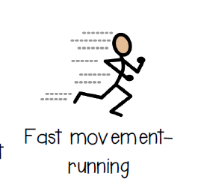
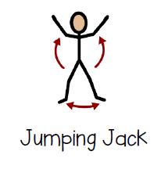
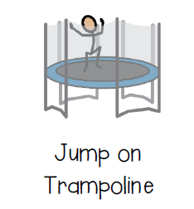
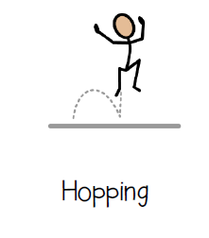
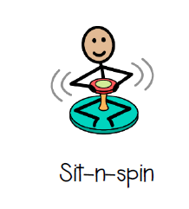
Alerting section
Notes:
Images taken from a sensory room activities' list : put together by Vanessa Ghiringhelli, found on TPT store
Images taken from The Picture Communication Symbols are used with permission: SymbolStixLLC
PO Box 550 Huron, OH ©2014 SymbolStixLLC
These activities are also recommended in the sensory circuit book , they are easy to set up and all of the equipment can be found in a PE department. Some activities require a space to use , while others required some mats for the floor.
All of the next 3 slides will be used with my TA as a guide to the sections and the types of activities we can do to help children

Slide 15
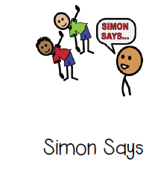
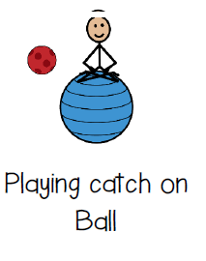
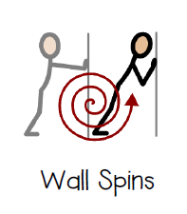
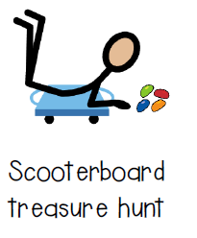
Organising section
Notes:
Into this section I have also added step boxes where students step up and down using hand weights .
We also have a number of weighted balls, where the child will sit on the large ball, hold the ball in there hands and twist side to side . This can also be done standing .
In this section I will also use agility ladders where I will place different coloured cones in each square . The child will have to stand at the side and ether use their left or right foot to touch a designated cone or will bend down and use their left or right hand to touch a particular cone. This section is about challenging balance whilst getting the child to do something else and concentrate on what they are doing .
I have borrowed a board on wheels from the caretaker which is essentially the same as a scooter board. If the students enjoy using it I will buy some proper scooter boards.

Slide 16
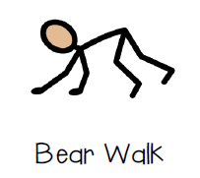
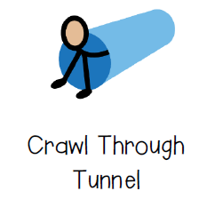
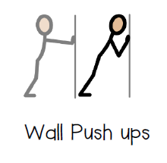
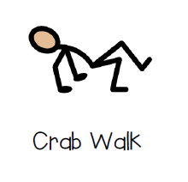


Calming section
Notes:
Using recommendations from the occupational therapist that has worked with child B this section will include pushing activities using the hands . For example interlink the fingers and pull the hands while they remain interlinked , place hands in prayer position and push the hands together with arm out at right angles, place interlinked fingers on the head and pull the hands down onto the head .
We are also going to have a number of bags filled with heavy books in particular classrooms . If we feel a child needs a sensory break and they are becoming overstimulated we may send them to collect a bag of books from one room and deliver them to another.
These visuals will be great for the TA who will be working with the students as it will help to show them the different sections. We really don’t want to send students back to lessons hyper !

Slide 17

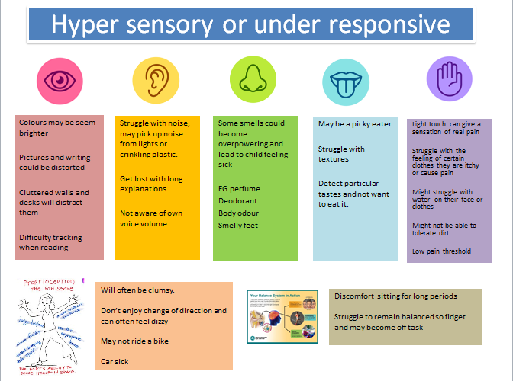
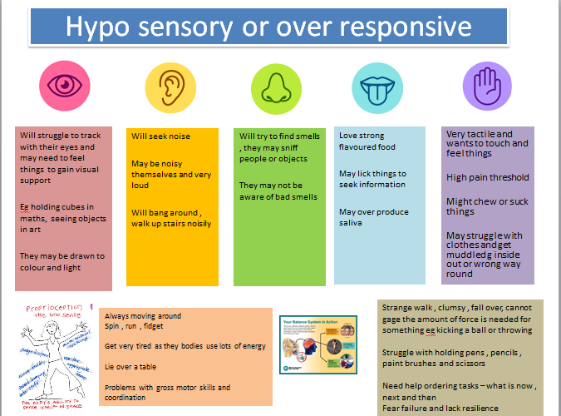
What do we need to find out ?
I have carried out a baseline of child B:
.
1.Parent sensory organizing worksheet - taken from The sensory child gets organized, Caroline Dalgleish. (See Appendix 2.
2. School observations from class TA
3. What do we already know and working with the OT what kind of activities do they suggest.
Pixy.org
Ask the child Q’s to work out which senses need working on.
Notes:
Dalgleish ( 2013) The sensory child gets organized , Touchstone book – I have used the sensory organiser to find out more information from parents ( see appendix 4)
To have a meaningful base line it is important to go to different sources :
The parents may see different behaviours at home to what we will see in school and vice versa. They can also give us an idea of the types of situations that will lead to crisis or overload or even when they are underwhelmed and need to wake up their senses.
The TA can often spot the signs when the child is becoming overloaded and is often the first person to put an adjustment in place for the child ie realise they are become stressed so take them on a walk around the building or take them to the sensory box to use a fiddle toy.
The OT report is quite specific and will help us to ensure we are following the exercises in sections.

Slide 18
What do we already know about child ( from parent response and OT work)
Create a list that is applicable to the child in question
Notes:
Some of this information has come from parents , the childs EHCP and the Occupational Therapist.

Slide 19
Intended outcomes
To carry out a set sensory circuit each day for 15 minutes that will be divided into 3 main stages.
To gradually increase the difficulty of the activities once the child becomes more competent
We should see a difference in how the child copes each day with lessons and hopefully parents will be able to feedback how the child feels once they return home.
We should be able to determine if one session per day is enough to help self regulate the child especially if they also carry a weighted bag and use stress reliever toys during lessons.
Notes:
What I have not factored in here is the cost . In terms of basic equipment I can find most of it from the PE cupboard , but I have spent £20 on a wobble board and a tunnel that came from Amazon.
What this project does cost is adult time and this needs to be factored into student provision maps. At present I have availability in tutor time but after Christmas I will lose this time and I will be relying on training the bridge manager to carry these sessions out.

Slide 20
I will train up 2 x TA and the Bridge manager , this means we always have at least 1 member of staff on hand to work with Student B .
The session will last about 15 minutes per day and if necessary can run over into break time.
I am also going to design a program of self regulation that children can use in lessons if they feel they are becoming anxious using strategies from :
Brukner ( 2017) Stay cool and in control with the Keep Calm Guru
Brukner ( 2014)The kids guide to staying Awesome and on Control
Notes:
The 2 students I have begun to work with have already begun to use these strategies in lessons. I now understand when people talk about having bands wrapped around chairs – it allows students to push their legs back into the bands giving them some relief.
After Christmas the Bridge manager will take over these sessions as I have been given a tutor group to look after.

Slide 21
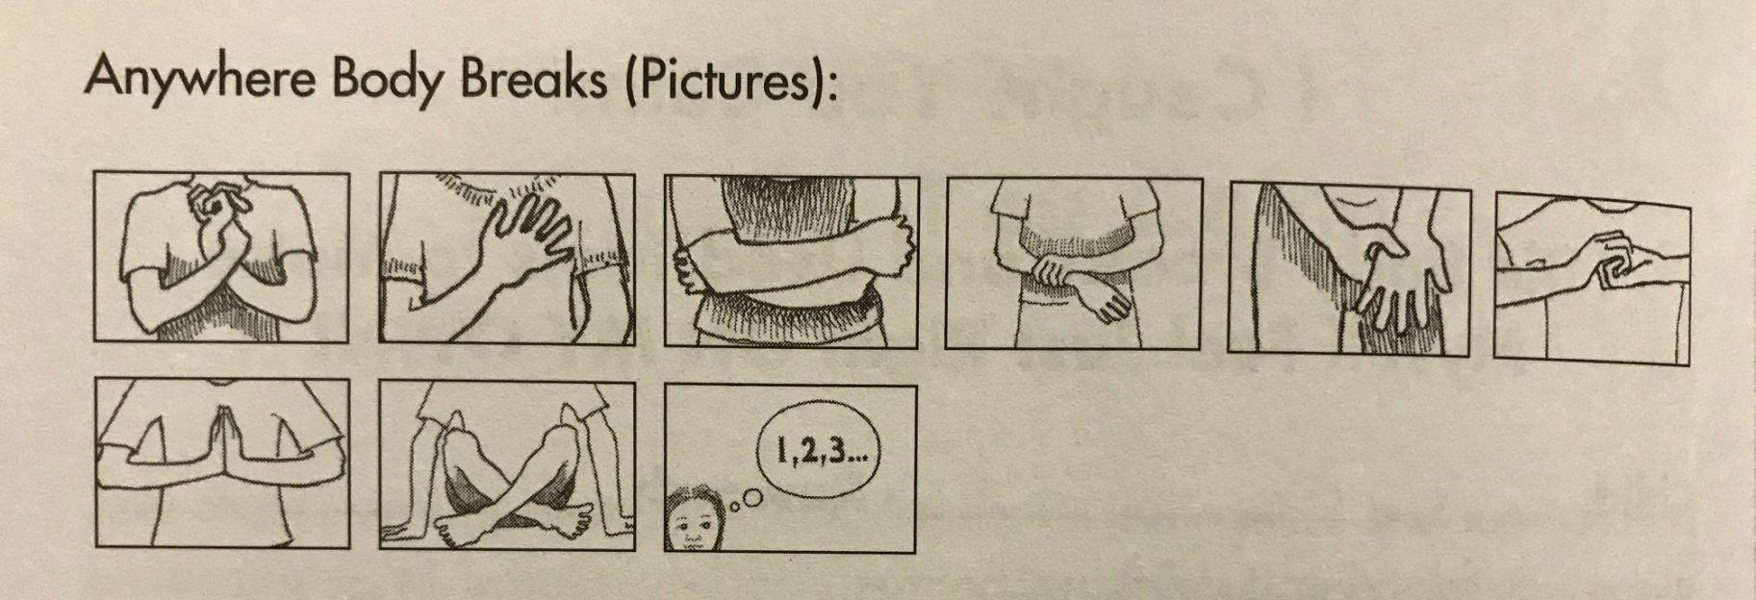
Strategies for during lessons.
Taken from the kids guide to staying Awesome and in Control. Brukner (Pg94)
This mini guide will be laminated and stuck in the child's planner. A time out may give them enough time to perform some of the above exercises and then return to class.
Notes:
Brukner ( 2014 ) talks about “ anywhere body breaks” ( p21) , she gives 6 reasons for doing these.
Firstly they only require the body and no equipment , secondly they can be done anywhere.
This means students can do them in the classroom or during break and lunch. Thirdly they are not necessarily obvious to others – some of my students struggle with feeling different and would not want to do anything that makes them stand out.
Number 4 is that they are great technique to do at any stress points eg before a group presentation or an exam or if the child feels anxious.
Number 5 relates to the fact that if the child can do cross over activities ie the right hand crosses to the left the opposite side of the brain wakes up.
This is good for our child A as he often ends up quite sleepy.
Number 6 relates to the fact that these activities need deep pressure which can help the child feel in control of where they are. They are great activities to teach any child and would be beneficial to use before examinations or session that require the child to sit for longer periods.

Slide 22
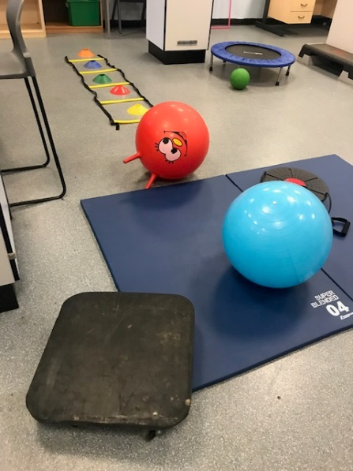
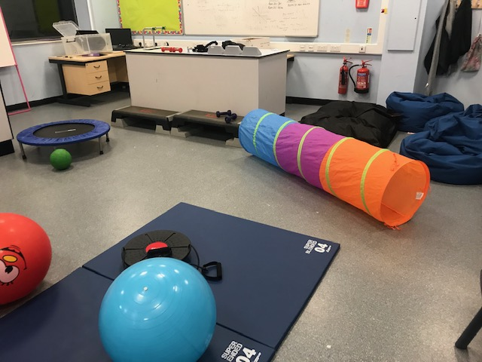
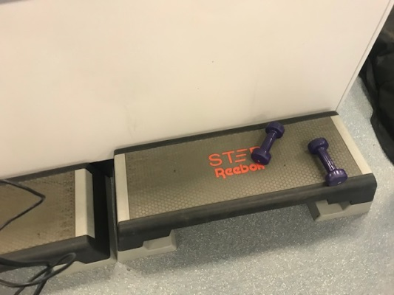
How we set up our room. We took an empty science lab and …….
Mini trampoline
Ladders with cones to develop r/l sided coordination
Wobble board with pull cords to hold
Scooter board
Step boxes various heights with weights
Space hoppers and gym balls to sit on or to roll over childs back
Tunnel to pull body through
Notes:
Being a PE teacher it was easy for me to get equipment . However I have plans to by some better scooter boards as ours has been borrowed off the caretaker !!! Amazon has been great for buying tunnels and wobble boards. We already had the bean bags. The room itself is a science lab that was used as a store room . The next stage is to move a lot of the furniture out to improve the space.

Slide 23
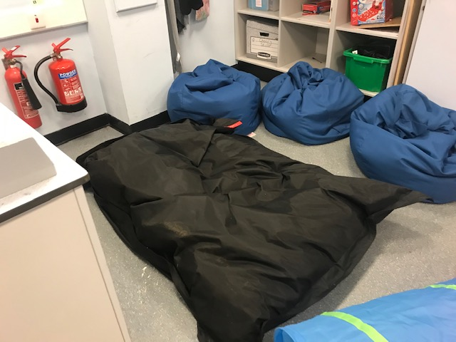
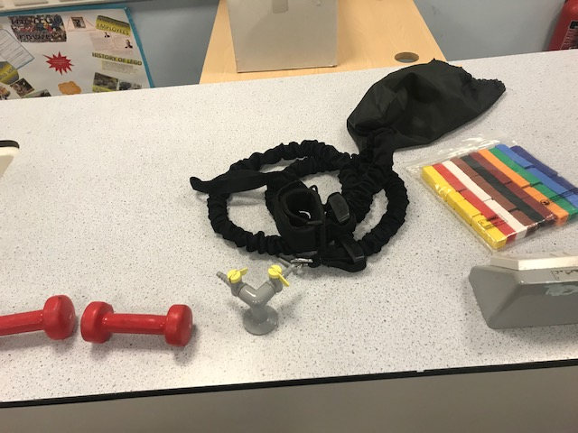
SAQ pull cord, attach to wrist and pull
Fine motor skill blocks
Various hand weights
Bean bag area for lying in or calming
Notes:
We had numerous bean bags in different rooms around the building that were not being used. We have created a bean bag corner. The large black one is great for jumping on and the blue are great for sitting and squashing into.

Slide 24
References
Aspergers central.com May 2015 https://www.youtube.com/watch?v=LAzw-Af_MnA&t=58s
Benne ( 2016 ) https://autismawarenesscentre.com/does-my-child-have-sensory-processing-disorder/
Brukner ( 2014) The kids guide to staying Awesome and on Control . Jessica Kingsley Publisher
Brukner ( 2017) (Stay cool and in control with the Keep Calm Guru . Jessica Kingsley Publisher
Canavan ( 2015 ) Supporting pupils on the autism spectrum in primary schools , Routledge publishing
Canavan ( 2015 ) Supporting pupils on the autism spectrum in secondary schools , Routledge publishing
Arkey ( no date )https://childmind.org/article/sensory-processing-issues-explained/
Dalgleish ( 2013) The sensory child gets organized , Touchstone book
Daniels ( 2018 ) Visual learning and teaching and essential guide for educators K-8 , Free star publishing
Daniels ( 2018) https://www.insightresources.org/2019/04/26/why-visual-learning-and-teaching/
Horwood ( 2008 ) Sensory circuits, a sensory motor skills programme for children . LDA Publishing
Mahoy ( 2015) https://www.youtube.com/watch?v=K2P4Ed6G3gw

Slide 25
Pixy.com ( picture )
Sensory Mini’s Sue Allen and Anthea Thornton (2019) https://www.youtube.com/watch?v=ueDQjhJDqIg
Sensory Mini’s Sue Allen and Anthea Thornton (2019) https://www.youtube.com/watch?v=Oquc160D1dw
https://www.smartkidswithspd.org ( no date )
worldatlas.com ( picture)
https://www.webmd.com/children/sensory-processing-disorder#1 ( no date )

Slide 26
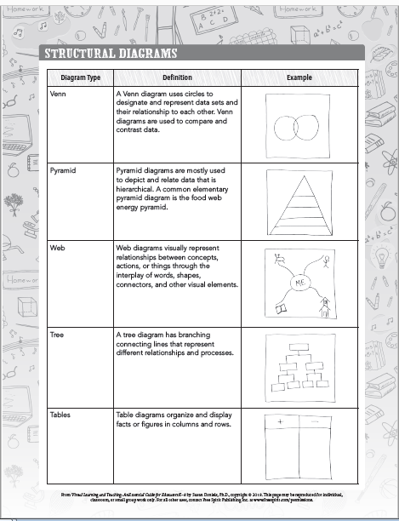
Appendix 1
Daniels ( 2018) visual learning and teaching an essential guide for educators k-8

Slide 27
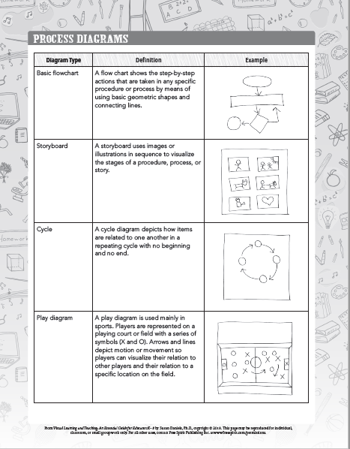
Appendix 2
Daniels ( 2018) visual learning and teaching an essential guide for educators k-8

Slide 28
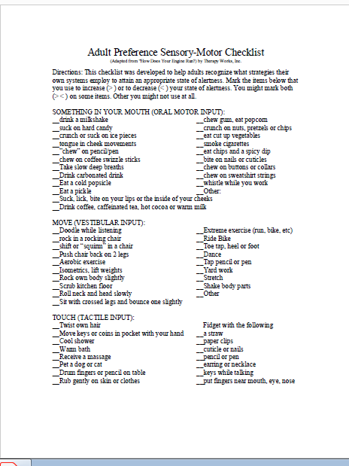
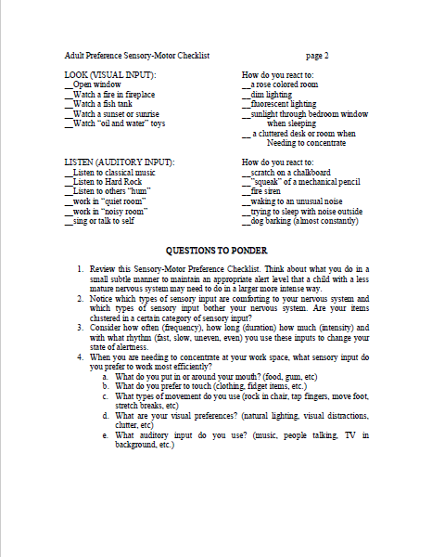
APPENDIX 3

Slide 29
Appendix 4
Sensory organising worksheet
1.What are some of the main challenges your child lives with day to day . Are the core issues related to anxiety , rigidy and or attentional issues.
2.Do you see any sensory tendencies in your child? Do you notice any challenges or sensitivities around their ability to process information from their senses ( movement , sound, touch, smell, taste , seeing)
3.What are your child’s strengths, things they are good at , love to do?
4.List the 3 biggest challenges for your child that impact home for him/her and your whole family.
5. How does your child process information / learn best? visual, auditory or tactile?
6.What are the common triggers for your child( things that get him/her upset , anxious or overwhelmed)
7.How does you child calm down when upset.
8.Does your child have difficulty with transitions at home? If so what transitions at home cause the most anxiety or disruption ? ( eg morning cleaning teeth and getting dressed)
9. Does your child have a favourite colour , character or fascination ?
10.As a parent what are your top 3 issues you would like to work on with your child that would make the biggest impact on your day to day experience at home?

Slide 30
TA observation ( Appendix 5)
The TA was asked to observe:
How they sit. She can often slump forward and
Concentration / attention span
Collaboration with other students
Does the student fidget
Do certain tasks cause anxiety or distress
How the child is affected by noise, light, touch, smell.
Child B is a very quiet child. However the more comfortable she gets with students the more she relaxes and will smile and laugh.
She writes with her left hand but her hand turns inwards so she struggles with longer writing tasks. She often slumps over the desk so is not in a great position for writing
She will collaborate with other students as long as she does not feel uncomfortable.
She does not fidget and does not appear to distressed , although their have been times when she has taken herself to the bridge.
She does not like noise , she needs to be made aware when there is to be noise ie the fire alarm practice . She likes to go to the library at break time to play games or sit quietly. She is fine with lunch as it is a quiet sitting and there is less noise. She prefers to leave lessons 1 minute early so she is not in the corridor rush between lessons. She enjoys art but does not like getting her hands dirty –we have had to think about some of the painting or smudging work that we do and let her wash her hands when she needs to .
She does not like to be touched . She finds it difficult when people look over her to see her work as she is often hunched and then she curls up more.
She is sometimes late in the morning , this is often due to having a crisis moment before school.

