Slide 1
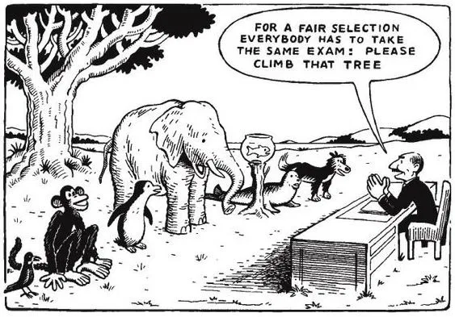
Differentiation
Notes:
2 mins

Slide 2
What does differentiation mean to you?
Notes:
5 mins

Slide 3
Differentiation is | Differentiation is not

Slide 5
Notes:
5 mins

Slide 6
Convery and Coyle (1993)
Differentiation is “the process by which teachers provide opportunities for learners to achieve their potential working at their own pace, through a range of relevant learning activities”

Slide 8
Quality first teaching
All teachers are teachers of SEND
We need to think of differentiation as a culture rather than a act or a “bolt on”
This is really about thinking about what the students in front of you need to access the result you want them to achieve.

Slide 9
Resources | The use of appropriate resources is vital
Room | The learning space needs to reflect and promote differentiation, allowing space for different ways of learning and recognising the different learning needs of different children
Relationships | We all know that relationships are key to successful teaching and these need to underlie differentiation. The adults in the room need to really know their pupils and the different ways of relating to them.
Robustness | This is linked to the resilience that the pupil is able and willing to demonstrate their efforts regardless, by volunteering answers or engaging during class feedback or discussion.
Relevance | The curriculum and resources needs to be relevant to the learner
Response | At the heart of differentiation is the response that the adults in the room make to each child- and the responses that they subsequently elicit
Recall | This is the key element of effective and differentiated questioning and includes the use of prompts to support children to recall their learning
Retention | This refers to how far children are prompted for independence so that they can retain and apply their learning, rather than becoming prompt- dependant
Resilience | It is vital that children can learn through making errors and develop the understanding and resilience to accept that we learn from mistakes
Notes:
5 mins

Slide 10
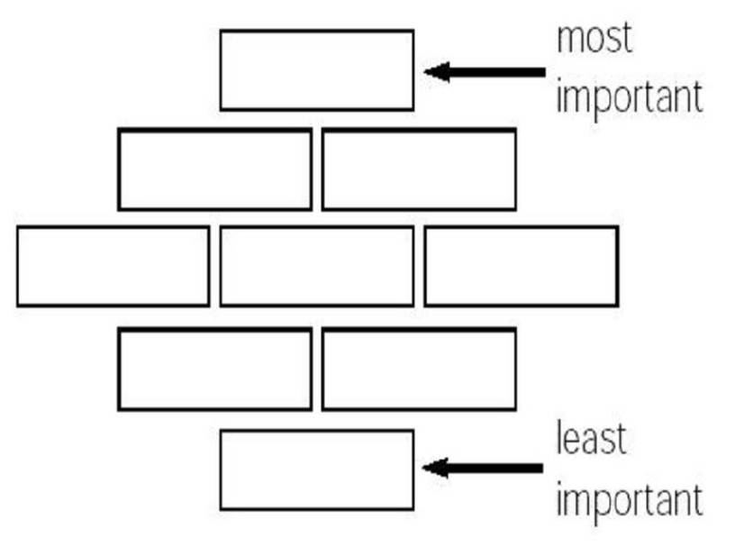

Slide 11
In pairs
Take 3 of the 9 statements and try to come up with a practical way of implementing this in your classroom/ subject area

Slide 13
Establishing routines

Slide 14
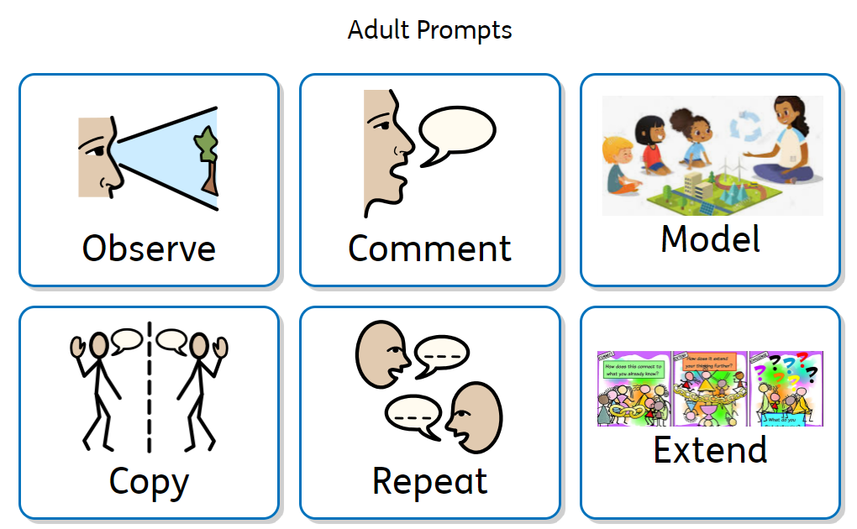

Slide 15
Support on drive
https://drive.google.com/drive/folders/1-sLQqW01W31ETnEF0V9YlqRg3-c6ELaj?usp=sharing
https://drive.google.com/file/d/137nDTGXptXMzrcYoyfNgvV0iJq5Dlpa5/view?usp=sharing
https://drive.google.com/file/d/1rEE6GcOPviT0FiPrUW28-jYhvQZY1MGV/view?usp=sharing
https://drive.google.com/file/d/1c1qBPDGAsbFqafoH75MekIzefWDeKjsU/view?usp=sharing

