Slide 1
Amazing TAs How to be the best Teaching Assistant

Slide 2
Education Endowment Foundation
‘Research that examines the impact of TAs providing general classroom support suggests that students in a class with a teaching assistant present do not, on average, outperform those in one where only a teacher is present. This average finding covers a range of impacts. In some cases teachers and TAs work together effectively, leading to increases in attainment. In other cases pupils, particularly those who are low attaining or identified as having special educational needs, can perform worse in classes with teaching assistants.’

Slide 3
EEF Recommendations
TAs should not be used as an informal teaching resource for low-attaining pupils
TAs to add value to what teachers do, not replace them
TAs to help pupils develop independent learning skills and manage their own learning
TAs are fully prepared for their role in the classroom
TAs to deliver high-quality one-to-one and small group support using structured interventions
Adopt evidence-based interventions to support TAs in their small group and one-to-one instruction
Ensure explicit connections are made between learning from everyday classroom teaching and structured interventions

Slide 4
The aim of TAs
“No matter what level of ability, regardless of whether the child is gifted or talented has SEN needs or a disability, or working at aged related expectations, the effective teaching assistant’s overarching aim is enable a pupil to move from needing assistance to being able to work independently.”

Slide 5
TASK What is your role? Write down what you think your role is.

Slide 6
The TA Role…
Their role is to help “Raise standards” by:
Support for the pupil.
Support for the teacher.
Support for the curriculum.
Support for the school.
Support staff can help to:
Raise the performance of individual pupils
Provide coping strategies for pupils
Assist in management of pupils behaviour
Promote pupils’ independence
Support the development of differentiated curricular approaches to meet the diversity of pupils’ learning needs

Slide 7
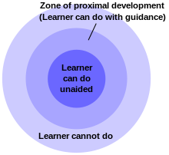
Some science: Vygotsky’s theory
Vygotsky (1896 -1934)describes the area between a child’s level of independent performance and what they can only do will support is the ‘Zone of Proximal Development’ (ZPD)
We should always aim to work within a child’s ZPD as in the diagram
If you work within the area that the learner cannot do the child will become frustrated, confused and disaffected with learning. Behaviour issues may become an issue

Slide 8
Teachers/TAs as Class Teams
You must benefit all the pupils in your class, not only at the top or bottom but across the spectrum! (You should not be superglued to a pupil!).
Promote the inclusion of students into their school/ class.
Be aware of what is being taught. Ask for a briefing
Observe pupil performance and provide the teacher with valuable thoughts on what works for pupils and what obstacles to learning they encounter

Slide 9
TASK Scaffolding – What is it? Write down different ways you can scaffold for a child who is struggling.

Slide 10
Scaffolding
There are 6 features of scaffolding
Gain and maintain the learners interest
Simplify the task, for example by breaking it down into stages
Control the child’s level of frustration
Point out key things to do and/or show the child alternate ways of doing parts of the task
Demonstrate the task
Keep child on-track by reminding them of their goal/learning objective

Slide 11
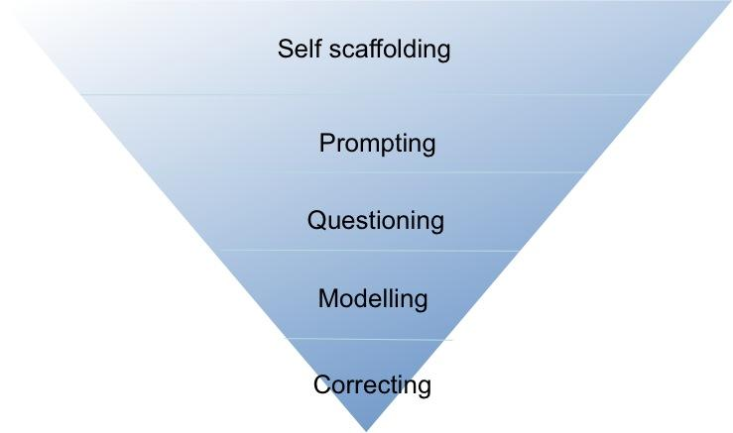
There are stages of progression within the scaffolding from high level of teaching assistant support from correcting to modelling, high order questioning and then prompting, requiring a low level of teaching assistant support until independence is obtained.
Help with recall, teaching assistants to give prompts
Low TA support, increased pupil independence
Cluing
Turn instructions into questions
Demonstrate with a running commentary
High TA support, low pupil independence

Slide 12
Ways to scaffold
offering a motivational context to pique student interest or curiosity in the subject at hand facilitating child engagement and participation
breaking a complex task into easier, more "doable" steps to facilitate student achievement
use visual aids and resources such as work mats, key word prompts.
tap into prior knowledge by asking children to share their experiences, hunches and ideas
showing students an example of the desired outcome before they complete the task
modelling an activity for the students before they are asked to complete the same or similar activity
modelling the thought process for students through "think aloud" talk
using verbal cues to prompt student answers

Slide 13
Ways to scaffold
teaching children chants or mnemonic devices to ease memorization of key facts or procedures
displaying a historical timeline to offer a context for learning
using graphic organisers to offer a visual framework for assimilating new information
teaching key vocabulary terms before reading
guiding the children in making predictions for what they expect will occur in a story, experiment, or other course of action
asking higher order questions while reading to encourage deeper investigation of concepts
offering hints or partial solutions to problems
suggesting possible strategies for the students to use during independent practice
Give pupils time to talk to each other and to the teaching assistant. Use ‘think, pair, share’ techniques. Pause, ask a question, pause and review to enable the child(ren) to process the information

Slide 14
Supporting Techniques…
Supporting learning by:
Relaying
Zoning
Coaching
Facilitating
Supervising
Safeguarding
Notes:
SLIDE 5: SUPPORTING TECHNIQUES
In-class support staff do not always permanently attach themselves to a student, instead adopting one or more of the following models (with agreement of teaching staff and/or after discussion in planning process:
Relaying – in-class support staff move periodically between students identified as being priorities for support due to additional needs.
Zoning – in-class support staff locate themselves near a group of students with additional needs, monitoring and providing input when necessary.
Coaching – in-class support staff are temporarily assigned to an individual or small group of students to guide them through a task that may prove particularly difficult (such as an extended writing or reading task when there are literacy difficulties).2
Facilitating – in-class support staff provide ‘drop-in support’ by setting up assistive technology or other specialised equipment in the classroom, adapting resources, helping a student organise coursework / homework etc.
Supervising – in-class support staff oversee the higher-ability / independent learners
Safeguarding – in-class support staff monitor, and where necessary, assist in activities that pose a manageable risk to the health and safety of a student with an additional need, particularly those with visual impairment, a medical condition or a physical disability.

Slide 15
Supporting Techniques…
In-class support staff do not always permanently attach themselves to a student, instead adopting one or more of the following models (with agreement of teaching staff and/or after discussion in planning process):
Relaying –move periodically between students identified as being priorities for support due to additional needs.
Zoning –locate yourself near a group of students with additional needs, monitoring and providing input when necessary.
Coaching –temporarily assign yourself to an individual or small group of students to guide them through a task that may prove particularly difficult (such as an extended writing or reading task when there are literacy difficulties).2
Facilitating –staff provide ‘drop-in support’ by setting up assistive technology or other specialised equipment in the classroom, adapting resources, helping a student organise coursework / homework etc.
Supervising –oversee the higher-ability / independent learners
Safeguarding –monitor, and where necessary, assist in activities that pose a manageable risk to the health and safety of a student with an additional need, particularly those with visual impairment, a medical condition or a physical disability.

Slide 16
Relaying
There have been concerns that TAs can encourage dependency, because they prioritise task completion, rather than encouraging pupils to think and act for themselves. Taken further, it has been argued that over-reliance on one-to-one support leads to a wide range of detrimental effects on pupils, in terms of interference with ownership and responsibility for learning, and separation from classmates.
Move periodically between students identified as being priorities for support due to additional needs.
The seating plan must facilitate this. It is important not to sit all students with SEN together.
This Photo by Unknown Author is licensed under CC BY-SA
Notes:
SLIDE 6: RELAYING
Often TAs feel the need to attach themselves to one particular student. This can be a waste of time and resources.
An effective TA will move periodically between students identified as being priorities for support due to additional needs.
ACTIVITY
How would you identify which students to support in each class?
How would you discuss this with the class teacher?

Slide 17
Zoning
Locate yourself near a group of students with additional needs, monitoring and providing input when necessary.
Notes:
SLIDE 7: Zoning
TAs locate themselves near a group of students with additional needs, monitoring and providing input when necessary.
ACTIVITY
How would you identify where to position yourself in a class to maximise your ‘zone’?
How would you discuss this with the class teacher?

Slide 18
Coaching
Assign yourself to an individual or small group of students to guide them through a task that may prove particularly difficult.
Notes:
SLIDE 8: Coaching
TAs are temporarily assigned to an individual or small group of students to guide them through a task that may prove particularly difficult (such as an extended writing or reading task when there are literacy difficulties).
ACTIVITY
How would you identify which students to coach and when’?
How would you discuss this with the class teacher?

Slide 19
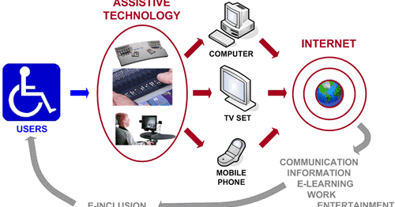
Facilitating
Provide‘drop-in support’ by setting up assistive technology or other specialised equipment in the classroom, adapting resources, helping a student organize.
Notes:
SLIDE 9: Facilitating
TAs provide ‘drop-in support’ by setting up assistive technology or other specialised equipment in the classroom, adapting resources, helping a student organise coursework / homework etc.
ACTIVITY
How would you identify when and how to use drop in support’?
How will you ensure that you can operate any required equipment, resources or machinery effectively?
How would you discuss this with the class teacher?

Slide 20
Supervising
Oversee the higher-ability / independent learners
Notes:
SLIDE 10: SUPERVISING
The needs of the most able learners is often neglected when schools consider students with special educational needs.
Often teachers would not naturally think of assigning a TA to support the learning of most able students but why not?
ACTIVITY
Do you think a class teacher should assign a TA top support able students?
How would you identify an exceptionally able learners in need of support’?
How would you discuss this with the class teacher?

Slide 21
Safeguarding
Monitor, and where necessary, assist in activities that pose a manageable risk to the health and safety of a student with an additional need, particularly those with visual impairment, a medical condition or a physical disability.
Notes:
SLIDE 11: SAFEGUARDING
TAs monitor, and where necessary, assist in activities that pose a manageable risk to the health and safety of a student with an additional need, particularly those with visual impairment, a medical condition or a physical disability.
ACTIVITY
How would you identify an activity that may pose a manageable risk to a student?
How would you identify an appropriate support strategy’?
How would you discuss this with the class teacher?

Slide 22
During the Introduction/Starter
You should never be stood/sat doing nothing,
Is there a group who don’t need this introduction – could you take a group straight away and get them going sooner? Challenging higher level/independent learners? Or scaffolding SEN pupils? Pre-teaching vocabulary?
Could you facilitate understanding of the learning objective?
Are there any pupils that would need support ‘getting started’?

Slide 23
During ‘Whole Class’ Teaching…
Ask the teacher where they would like you to work? Ensure the TA knows where they are supposed to be.
Identify key pupils/groups
Task should not be to keep students focused when the time is too long or the activity is inappropriate.
Bes a role model – demonstrating appropriate behaviour. Don’t distract the pupils – ask when you should intervene.
Focus on the PUPILS not the teacher – you should already have ‘learnt’ what the lesson is about and shouldn’t need the input!
Have your TA Pack with you at all times

Slide 24
Small Group/Independent Work
knows where to work with the student or group and what resources they will need (in advance!)
Ask why you are working with a student or group and what support to give (are they observing? Facilitating? Monitoring?)
How will you feedback to the teacher?.
Ensure again you know the LEARNING OBJECTIVE – this isn’t the same as the activity, how will you know if the pupil is successful (success criteria?)
Ask what you should do if the children have finished/ achieved the learning objective.

Slide 25
To conclude
The effective deployment of TAs can make the difference between a student succeeding or failing.
An outstanding TA is intuitive and responds to the needs of the students.
It is important that both teacher and Teaching Assistant work together.
All the students in the class must be learning throughout the lesson. students should make progress through suitably challenging activities and questioning.
Thinking time is good; down time is not.
Notes:
SLIDE 15: To conclude
The role of the Teaching Assistant is very important. The effective deployment of support staff can make the difference between a student succeeding or failing. Much of the Teaching Assistant’s role is directed by the teacher, but an outstanding TA is also intuitive and responds to the needs of the students.
It is important that both teacher and Teaching Assistant work together with the aim that all the students in the class are learning throughout the lesson. students should make progress through suitably challenging activities and questioning.
Thinking time is good; down time is not.

Slide 26
Break – 10 minutes

Slide 27
Key Information
Timetables have been worked out based on class timetables.
Fortnightly timetables are being trialled so children do not miss the same lesson each week
Full timetables start from Week 3 onwards
Timetables have been emailed to teachers and TA’s
EKN is the only person who can change/ alter your timetable
You should have all watched the ’How to run a successful intervention CPD’
Any concerns/issues need to come to EKN first as line manager before speaking to anyone else
Fortnightly group meeting will be put in place to share and have the opportunity for training

Slide 28
During the next 2 weeks
Baseline Assessments
Phonics – Using phonics tracker online program (Years Reception, Year 1, Year 2) + Any pupils in the Year 3-5 who you think may not have a secure knowledge of sounds
Language Link - Using the speech link assessment program
(Years Reception and Year 1) + Any pupils in the Year 3-5 who you are concerned about their language development
Nursery ECAT assessment sheet
Dynamo Maths (Lowest 6 children in year 1 – Year 5)

