Slide 1
Supporting Independent Learning* *within a global pandemic

Slide 2
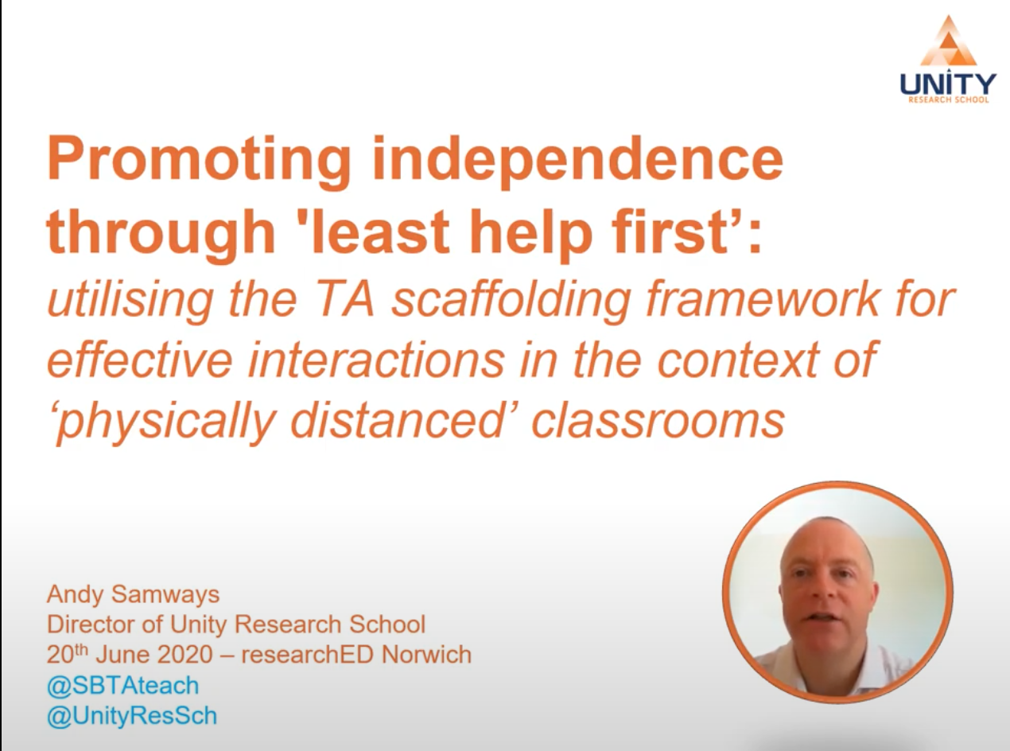
Context of Training:
Adam Samway’s “Promoting independence through least help first”
Evidence based – EEF
Making best use of Tas (EEF, 2018)
Applies to all!
Notes:
Adam Samways – Director of Unity Research School
References TAs traditionally supporting 1-1/small group – but in a classroom where we are ‘socially distanced’ independence is even more key than it has been in the past.

Slide 3
Overview:
How can we support and teach these in our pupils?
(Mannion, 2020)
Notes:
Metacognition -

Slide 4
Metacognition:
Knowledge of the subject and task: prior knowledge, vocabulary, strategies of how to approach the task…
The things we plan for?
Pupil’s awareness:
How can I do it?
How can I check it’s working?
Was I successful today?
This creates independence…

Slide 5
Self- Regulation
Monitoring and controlling how you interact with an environment through emotions and behaviour.
Being aware of your strengths and weaknesses.
Poses a unique challenge with vulnerable pupils, where they have been at home for 5 months…
Notes:
This in itself, before going any further – raises concerns with regards to our pupils. – but will return to this at the end of the training.

Slide 6
(Mannion, 2020)
Notes:
An understanding of the task, subject specific knowledge and regulating your emotions = self regulated learning.
A balance of supporting yourself alongside an appropriate level of challenge, ensuring you are successful and ask for help when it is needed.

Slide 7
Learning Tasks: Zone of Proximal Development (ZPD)
ZPD is the zone in which children can problem solve under adult guidance, or with more capable peers.
Where we aim for all learning tasks to be.
Aim – more and more problem solving tasks to be achieved independently.
Scaffolding
(Vygotsky, 1978)

Slide 8
Scaffolding:
A form of differentiation
Support through adults to reach a specific goal
Simplifying what a pupil has to do in order to be successful
Is not task modification
Pupils attempt the task independently, but structured support is offered for parts that are considered challenging.
Result: pupil completing the task independently
(Wood, Brunder & Ross, 1976)

Slide 9
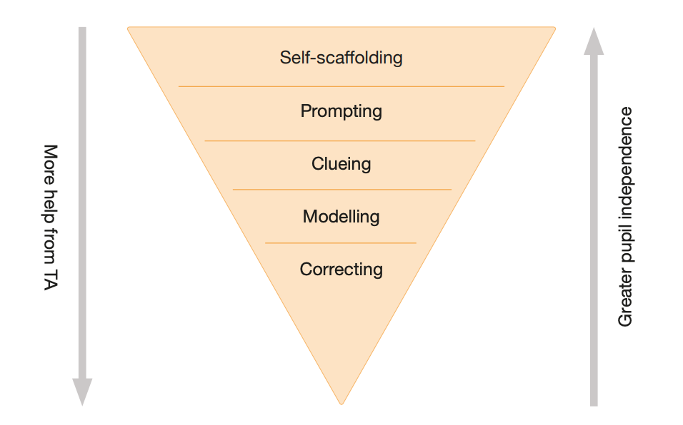
Pupil Independence
Classroom environments
“What comes first?”
“You can do it!”
Include a clue to the next step
“What did I do next?” ”Think about…”
Resources!
Show them in replicable, small steps
Watch the child after, follow each singular step
(EEF, 2018)
Notes:
Least Help First Intervention
Talk through different levels, top down – layers of support.
Avoid bottom, correcting, as a method of support. There is a place for knowing whether you were correct or not, most often as a tool for evaluating success, but not as a strategy for scaffolding or supporting a pupil.

Slide 10
Examples of clues/prompts:

Slide 11
Examples of clues/prompts:

Slide 12
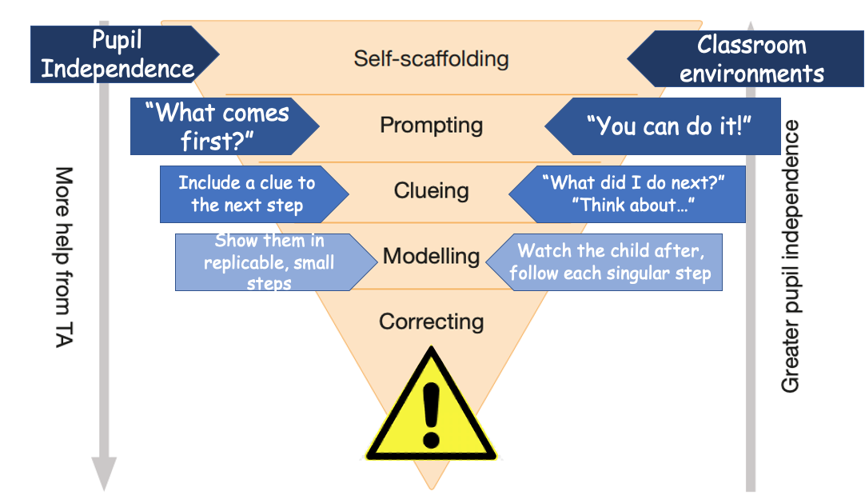
Your planning:
Have a look for a possible misconception or think of a challenge for a particular child.
What could the scaffold be, at each level, for that task?
Who could deliver the scaffold?
What could your classroom environment look like to support this task?

Slide 13
Self- Regulation
Monitoring and controlling how you interact with an environment through emotions and behaviour.
COVID-19
Disadvantage gap between those disadvantaged and not is only increasing.
Technology access
Home learning support
Home environments
And now they’re returning to us…
Notes:
This in itself, before going any further – raises concerns with regards to our pupils.
Challenging circumstances – safeguarding, home contexts, disadvantaged backgrounds…

Slide 15
Strategies for support in expanding a child’s window of tolerance:
Teaching them how to notice, communicate and manage their emotions
How to bring themselves back inside their window
Regulate their feelings for them and with them
Help identify, and foresee what their triggers may be
Create an environment that feels as safe as possible for them
Stay within our own window of tolerance

Slide 16
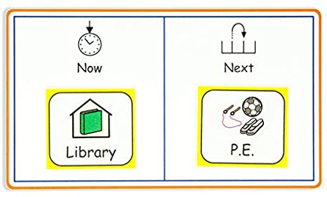
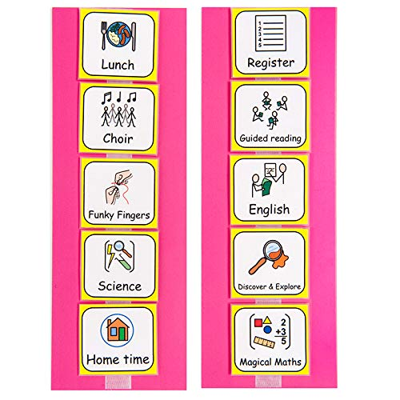
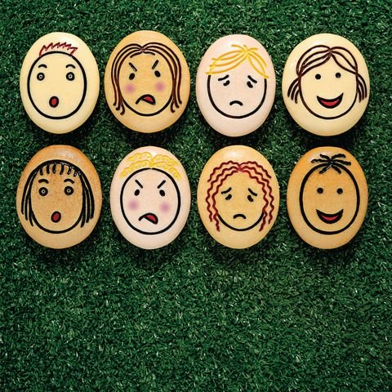
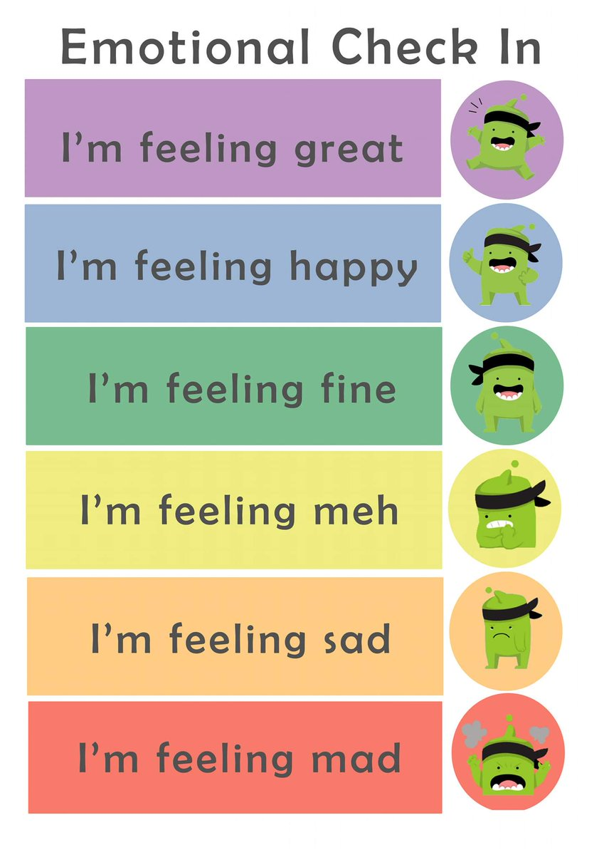
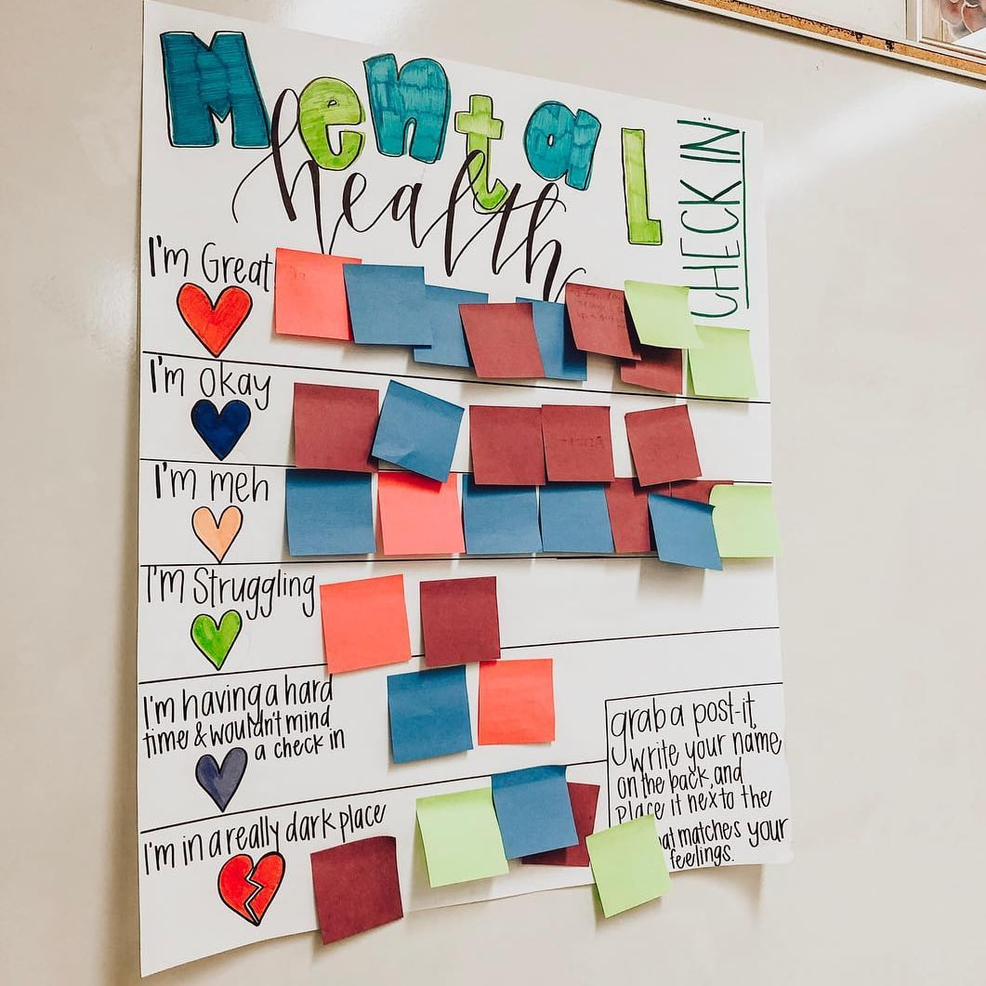
Strategies for support:

Slide 17
Next Steps:
Class team meetings for SEN support documents
Meeting all SEN pupils in the classrooms
Virtual parent meetings

