Slide 1
Session 1: I have ADHD: what does that mean?

Slide 2
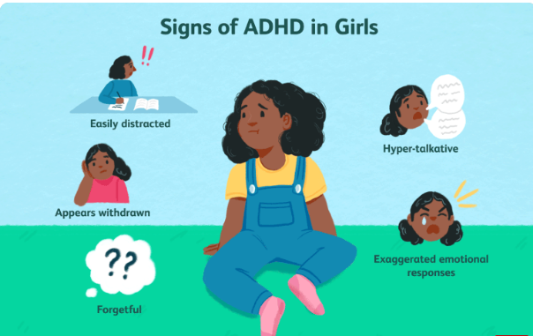
Understanding my ADHD

Slide 3
What is ADHD?
ADHD means you have a race-car brain.People with ADHD have a turbocharged brain. It can go really, really fast. The only problem is that sometimes it goes too fast.
Sometimes it needs medicine so it won’t overheat. But with the right medicine, it wins lots of races.
Do you sometimes have trouble paying attention in school? That’s because your mind is zipping around all over the place, bursting with new ideas. And that’s great! That’s why you’ll do amazing things and have fun all your life. But you need help taking care of your race-car brain.
Having attention-deficit disorder is a bit like being left-handed. It is part of who you are, not who you are.

Slide 4
At times, all children have trouble paying attention, listening, sitting still or waiting their turn. But people with ADHD have trouble with these things almost all the time.
People with ADHD aren't being this way on purpose. ADHD is a medical condition that affects their attention and self-control. Because of ADHD, they have a harder time staying focused. ADHD can also make them more fidgety than other children their age.
People with ADHD might find controlling their behaviour tricky and get into trouble more. This can make it hard to do things like pay attention in class or get along with others.
ADHD stands for attention deficit hyperactivity disorder. That's the medical term for difficulties with attention and self-control that can make you fidget and move a lot.

Slide 5
What Causes ADHD?
ADHD is caused by differences in the brain's ability to pay attention, slow down, and be patient. It's not clear what causes these brain differences, but doctors know that ADHD is in a person's genes. Most kids who have ADHD have a parent or relative with ADHD.
ADHD is not caused by eating too much sugar. And it's not something a kid does on purpose.

Slide 6
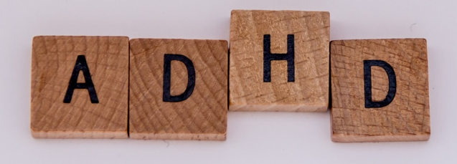
What Are the Signs of ADHD?
Kids with ADHD might:
have trouble listening and paying attention
need lots of reminders to do things
get distracted easily
seem absent-minded
be disorganised and lose things
not sit still, wait their turn, or be patient
rush through homework or other tasks or make careless mistakes
interrupt a lot, and talk or call out in class when they shouldn't
do things they shouldn't, even though they know better
feel restless, fidgety, frustrated, and bored
If someone has a lot of these signs, and these problems happen most of the time, it might be ADHD.
Activity 1: Go through the list above and highlight the signs of ADHD that you feel you show.

Slide 7
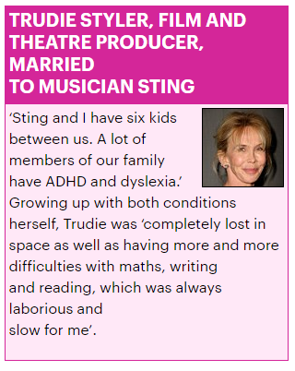
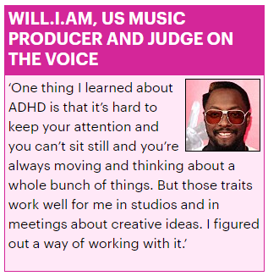
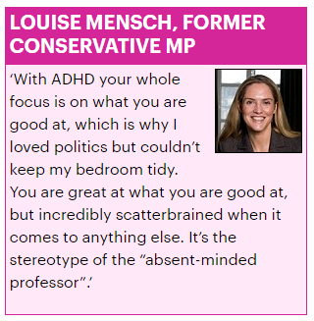
Session 2: Lots of amazing and successful people have ADHD and consider it a gift.

Slide 8
Things to love about ADHD
Hyperfocus gives you incredible drive.
Resilience
A sparkling personality
Generosity
Ingenuity
A strong sense of what is fair
Willingness to take a risk
Spontaneity
A Ferrari brain
Being funny
Being a good conversationalist
Believing anything is possible
Compassion
Persistence
Creativity
Being able to see things from another perspective
Willingness to fight for something you believe in
Motivating others

Slide 9
Benefits of having ADHD
ADHD is often thought of as a disability. But there are lots of positive things about having ADHD. Some people with ADHD say:
They have lots of energy, which can be channelled into work, sports and hobbies.
They are highly creative. Many successful and famous entrepreneurs have ADHD.
They are excellent problem solvers, due to out-of-the-box thinking.
They have an excellent sense of humour and fun, which makes people gravitate toward them.
They are very curious about the world and are lifelong learners.
Grown-ups can seem younger than their age, thanks to their energy, enthusiasm for life, and curiosity about the world around them.
They are sensitive, understand how other people are feeling, and can respond accordingly.
They are forgiving, trusting and loving, which, with the right person, can mean a long and happy relationship or friendship.

Slide 10
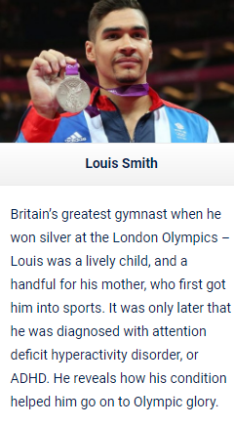
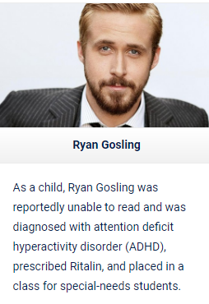
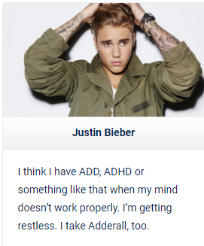
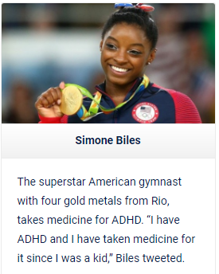
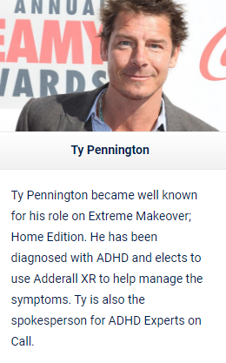
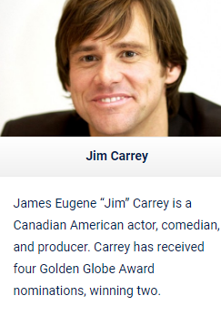

Slide 11
These famous people had/ have ADHD:
Albert Einstein ( genius scientist and mathemetician)
Mozart (genius composer)
Jusin Timberlake
Leonardo de Vinci (genius artist and inventor)
Jamie Oliver
Will Smith
Walt Disney
Steve Jobs (genius founder of Apple)
Will.i.am

Slide 12
Activity 1
Activity 2
Choose one of the people who have ADHD and research their amazing achievements.
Think and talk about how ADHD helped them achieve their goals.
Make a list of amazing things you want to achieve in your life.
Think and talk about how your ADHD could help you achieve your goals.

Slide 13
Session 3: How to help myself be successful

Slide 14
What's it like for children with ADHD?
Having ADHD can be difficult sometimes. Kids may get in trouble for things they can't help — like not listening, losing their temper or doing things too fast. That can make them feel bad about themselves. At times, they may mistakenly blame themselves for ADHD. But ADHD is not a kid's fault.
Parents, teachers, and therapists can help people get better at paying attention, slowing down, and gaining self-control. They can teach kids to use their strengths and energy in good ways. Kids with ADHD can improve their attention and self-control, do well in school and activities they enjoy, and feel good about themselves.

Slide 15
How to help myself:
It may be hard to learn that there is no cure for ADHD. However, the symptoms can be successfully managed and treated.
If you take your medicine regularly, you can expect to see improvements in your concentration at school and you may notice your relationships, confidence and self-esteem improve as well.
There are other things that you do to help yourselves too, like:
Eat healthy food.
Get enough sleep.
Be active every day.
Practice mindfulness exercises and breathing exercises

Slide 16
Behaviour strategies that work for people with ADHD
Establishing routines: Having simple, predictable routines throughout the day means important tasks get done without last-minute panics.
Checklists: A checklist can be made for anything that seems complicated or stressful. It acts as a memory aid and helps you feel organised. For example, you might pop a checklist near the front door listing all the things you need for the day.
Using timers: To help you pay attention to homework, set a timer for 15 minutes (indicating a dedicated time of focus). When it rings, have a mini-break and then set your timer again.
Setting alarms: You can set alarms to remind you to take medication. Alarms can be empowering because it reduces the need for reminders from others.
Creating charts: If there is a behaviour or habit you want to include in your day, make a chart with the days of the week. Every time you do the behaviour, for example, clean your teeth, you get a star. The chart acts as a reminder and a motivator to do the task.
Using planners: Using a planner helps with understanding the passage of time and what is planned for the day, and marks deadlines, like when homework needs to be handed in.

Slide 17
There are some websites that are dedicated to help people with ADHD
https://fastbraiin.com/adhd-strategies-thrive/

Slide 18
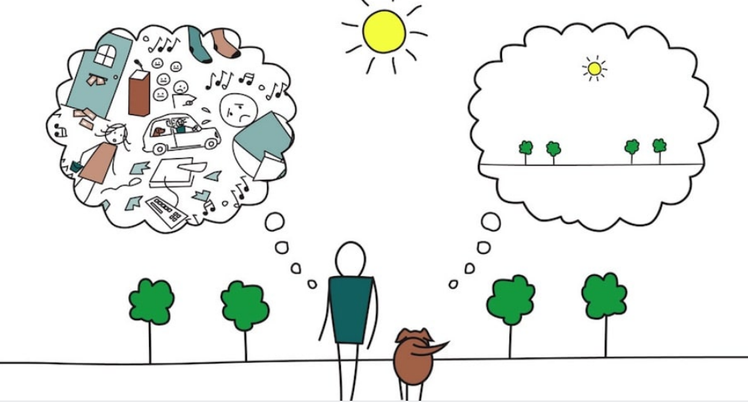
What is mindfulness?
Being mindful helps people do better in just about every part of life, like focusing on homework or feeling less stressed out. Practising mindfulness a little bit every day helps you to build this valuable skill.
These exercises help you practice mindfulness in four different ways. Try doing all of them.
As you do each exercise, you will probably find that your mind wanders after a minute or two. That's normal — minds do that. Your job is to gently bring your attention back to the thing you are focused on. The more you practise doing that, the better you train your brain to pay attention.

Slide 19
Mindful Breathing
With this exercise, you focus your attention on breathing. You want to pay attention to your breath in an easy way — on purpose, but not forced.
Sit up in a comfortable way. Close your eyes.
Notice your breathing as you inhale and exhale normally. Just pay attention to your breath as it goes in and out. Can you feel the place where the air tickles your nostrils?
Pay attention to how the breath gently moves your body. Can you notice your belly or your chest moving as you breathe?
Sit for a few minutes, just paying attention to your gentle breathing. See how relaxed you can feel just sitting, breathing in and out.
When your mind starts to wander and think about something else, gently guide your attention back to your breathing.

Slide 20
Mindful Walking
This exercise is about paying attention to how your body moves as you walk slowly.
To start, pick up one foot and take a step forward, in slow motion. Pay attention to how you naturally keep your balance.
Now walk in slow motion, step by step. Notice how your arms and legs and feet move. Pay attention to how your knees bend and straighten, as you lift one foot and then the other, nice and slow.
Breathe in and out, in time with your steps. See if you can keep your attention focused on walking slowly, step by step, as you relax and breathe.
Whenever your mind wanders, gently guide it back to your s-l-o-w motion moving. Keep breathing, in and out, as you enjoy moving in slow motion.

Slide 21
Mindful Word
Think of a word that seems calm or soothing. This could be a word like "peace" or "love" or "peaceful" or "snowflake" or "sunlight" or "hum" or "calm."
Think the word to yourself. Say it silently and slowly in your mind. Say your word to yourself with each breath you take, in and out. Keep your attention gently focused on your word.
When your mind wanders, guide your attention back to your word, and keep saying it gently and slowly while you relax and breathe.
Can you do this for a whole minute? Can you do it for 5 minutes?
When you practise, you will probably notice that you feel calm and relaxed. If you keep practising, you might start to notice that it's easier to focus your attention on things like schoolwork or listening. You may begin to feel calmer and more patient in your everyday life. You may find that when little things go wrong, you can handle them better.

Slide 22
Mindful Eating
You can do this with an orange, an apple — or even something as tiny as a raisin. The idea is to really pay attention to what you are eating.
Let's say you decide to do mindful eating with an orange. Your job is to eat the orange slowly, without rushing. You can do this mindful eating exercise with your eyes open or closed.
Start by holding your orange. Roll it in your hand. Notice how it feels.
Hold the orange near your nose. What does it smell like? Take a whiff of the bittersweet smell of the orange peel.
If you have your eyes open, notice how the orange looks. Pay attention to whether the skin is smooth or bumpy. If you hold it firmly, is it squishy?
Slowly peel your orange, paying attention to how it feels in your fingers. Notice the juiciness, and whether the inside of the orange smells different from the outside.
Is your mouth watering? Go ahead and taste your orange. Notice how it feels on your tongue, and against your teeth. Notice the flavour, the texture, and the juiciness as you chew each piece slowly. Take your time as you chew, taste, smell, and feel each bite of your orange.

Slide 23
This is a poster for teachers with strategies to help them ‘deal’ with children with ADHD.
Task 1: Can you design a similar poster with strategies that helps you be successful in class?

