Slide 1
BE PROUD | AIM HIGH | WORK HARD | BE KIND | NO EXCUSES
Introduction to Metacognition
Yamina Bibi
@msybibi
Assistant Headteacher
https://sbpedagogy.wordpress.com/
BE PROUD | AIM HIGH | WORK HARD | BE KIND | NO EXCUSES

Slide 2
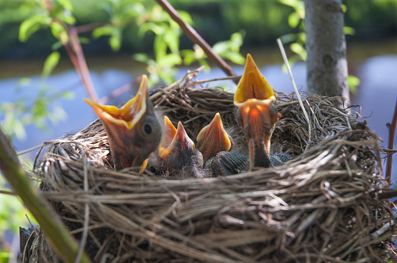
BE PROUD | AIM HIGH | WORK HARD | BE KIND | NO EXCUSES
THINK-PAIR-SHARE
What advice would you give a teacher who receives the questions below the moment a whole class task is set?
Madam, do we need to write in paragraphs?
Sir, what do I do now? I’ve finished.
Madam, what do I do when I get to the bottom of the page?
Sir, can you check this is OK?
Madam, how long do we have?
I don’t get it.
Notes:
3.15-3.18

Slide 3
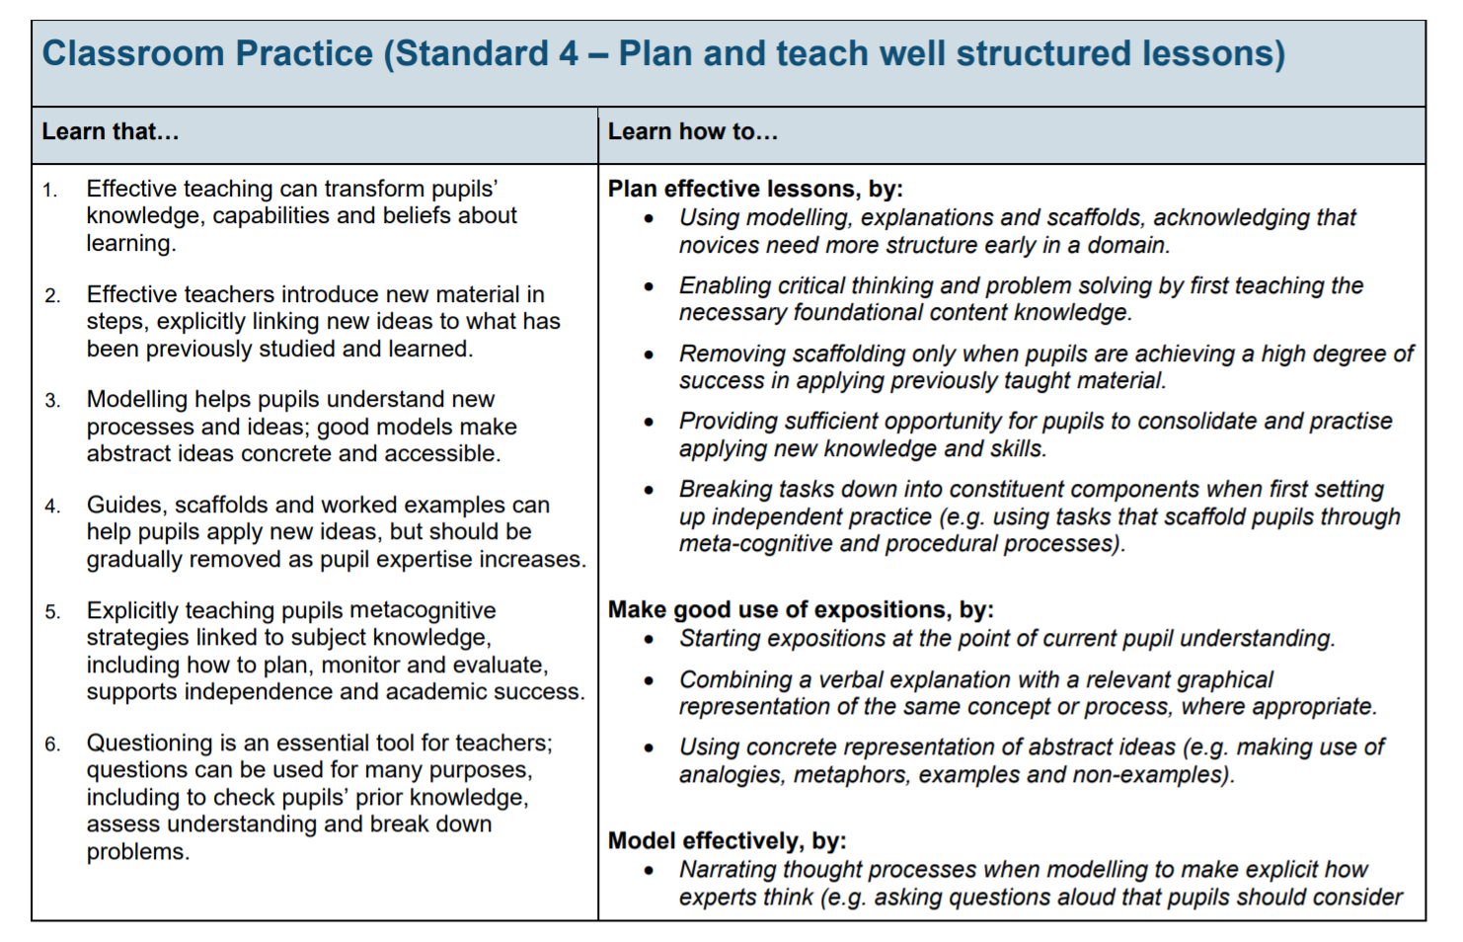
BE PROUD | AIM HIGH | WORK HARD | BE KIND | NO EXCUSES
How does this link to the ECF?
BE PROUD | AIM HIGH | WORK HARD | BE KIND | NO EXCUSES
Notes:
3.18-3.19

Slide 4
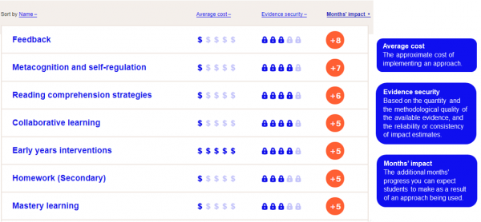
BE PROUD | AIM HIGH | WORK HARD | BE KIND | NO EXCUSES
Why Metacognition?
BE PROUD | AIM HIGH | WORK HARD | BE KIND | NO EXCUSES
Notes:
3.19-3.20

Slide 5
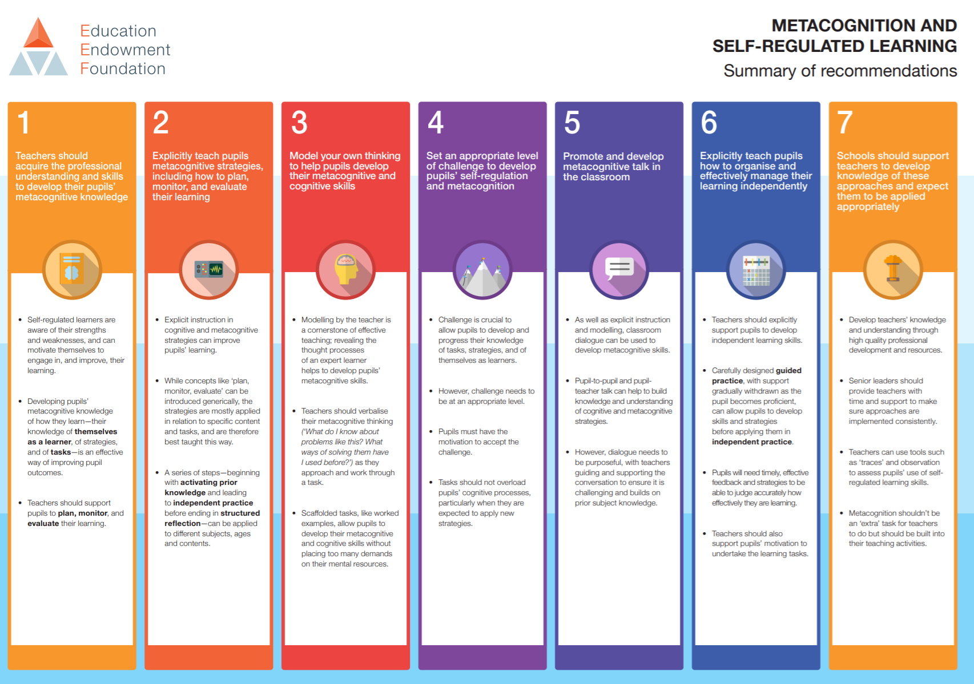
BE PROUD | AIM HIGH | WORK HARD | BE KIND | NO EXCUSES

Slide 6
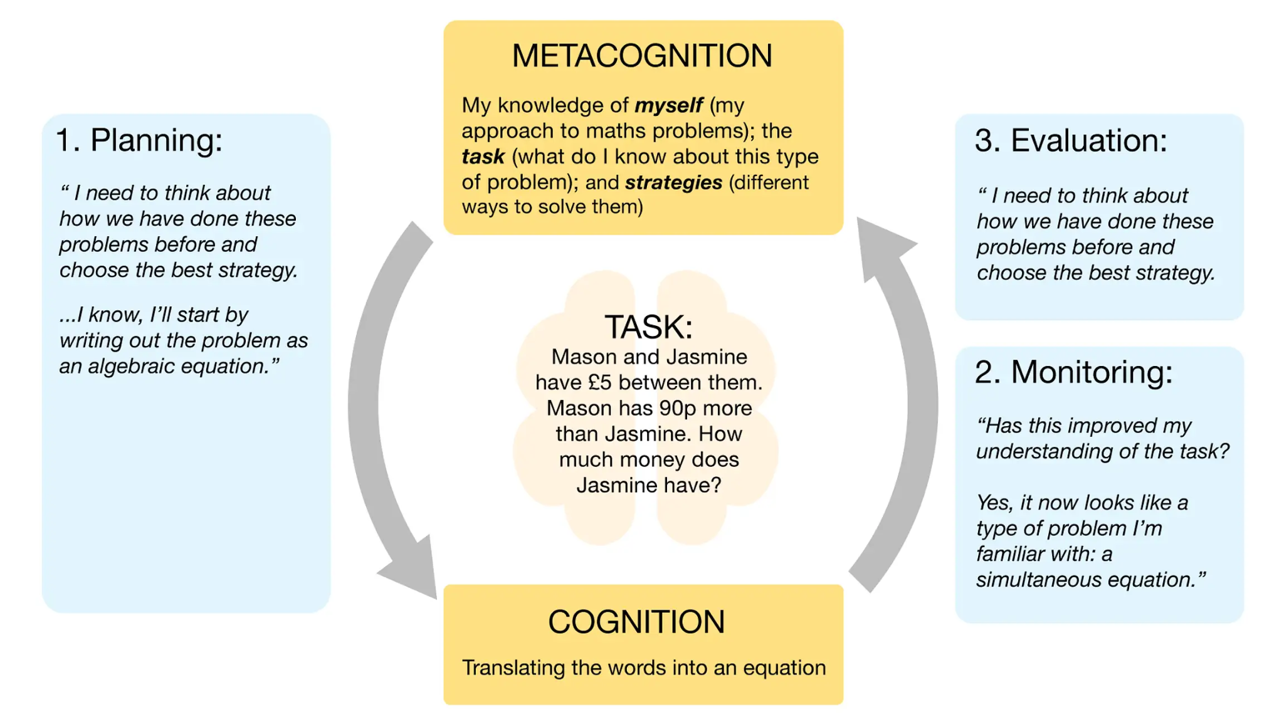
BE PROUD | AIM HIGH | WORK HARD | BE KIND | NO EXCUSES
What is Metacognition?
Alex Quigley et al. Metacognition and Self Regulated Learning-Education Endowment Foundation
BE PROUD | AIM HIGH | WORK HARD | BE KIND | NO EXCUSES
Notes:
3.20-3.21
YBI TO EXPLAIN THE KEY WORDS
METACOGNITION
Planning - goal setting, activating prior knowledge, selecting appropriate strategies, allocating resources.
Monitoring - including self-testing activities to control learning.
Evaluation - appraising the outcome of one’s learning, including deciding whether to use a different strategy next time.

Slide 7
BE PROUD | AIM HIGH | WORK HARD | BE KIND | NO EXCUSES
What is Metacognition?
Comprehension – Connection – Strategy – Reflection
Put simply this approach teaches students to:
Identify what they understand about the task/topic/information (COMPREHENSION)
Make links between this task/topic/information and things they have seen before (CONNECTION)
Identify the best approach they can use to complete the task (STRATEGY)
Evaluate how successful their approach was and how they felt about it (REFLECTION)
Tova Michalsky (2013) in Jennifer Webb’s ‘The Metacognition Handbook’ (2021)
BE PROUD | AIM HIGH | WORK HARD | BE KIND | NO EXCUSES
Notes:
Give example of planning a lesson for an interview. Comprehend-Connection -Identify-Evaluate will help you plan a lesson for a class you have never met before.
The comprehension, connection and strategy elements of Michalsky’s approach are very much in concert with how we learn.
These cognitive processes also explain to us why repetition and recall works: we strengthen neural pathways every time we engage with a piece of knowledge
This doesn’t just work for knowledge, but for behaviours, too.
When you practise a skill, your neural pathways associated with that skill are strengthened and the task becomes easier.
Over time, those actions might become automated and unconscious. If students are regularly practising metacognitive skills, such as making explicit connections between new and prior learning, and independently selecting strategies to succeed in tasks, these skills will eventually become second nature to them.

Slide 8
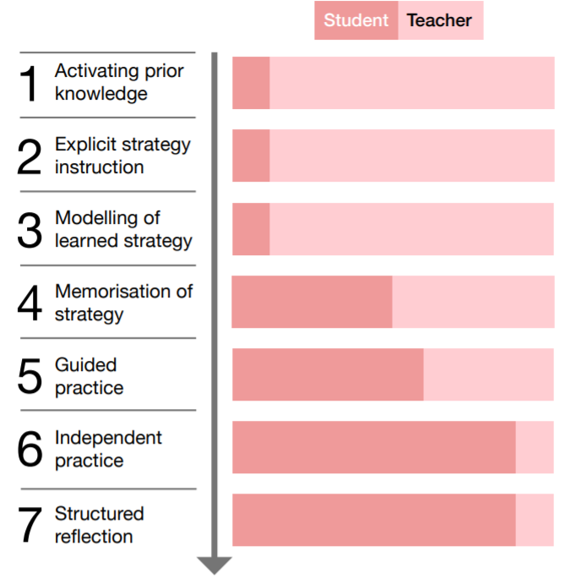
BE PROUD | AIM HIGH | WORK HARD | BE KIND | NO EXCUSES
How should we teach metacognitive strategies?
1. Activating prior knowledge
2. Explicit strategy instruction
3. Modelling of learned strategy
4. Memorisation of strategy
5. Guided practice
6. Independent practice
7. Structured reflection.
Education Endowment Foundation: Metacognition and Self Regulated Learning
Notes:
Once we know the strategies, the eef recommends this is the process we use to teach metacognitive strategies

Slide 9
BE PROUD | AIM HIGH | WORK HARD | BE KIND | NO EXCUSES
How should we teach metacognitive strategies?
Example
1. Activating prior knowledge. The teacher discusses with pupils the different causes that led to World War One while making notes on the whiteboard.
2. Explicit strategy instruction. The teacher then explains how the fishbone diagram will help organise their ideas, with the emphasis on the cognitive strategy of using a ‘cause and effect model’ in history that will help them to organise and plan a better written response.
3. Modelling of learned strategy. The teacher uses the initial notes on the causes of the war to model one part of the fishbone diagram.
4. Memorisation of learned strategy. The teacher tests if pupils have understood and memorised the key aspects of the fishbone strategy, and its main purpose, through questions and discussion.
5. Guided practice. The teacher models one further fishbone cause with the whole group, with pupils verbally contributing their ideas.
6. Independent practice. Pupils complete their own fishbone diagram analysis.
7. Structured reflection. The teacher encourages pupils to reflect on how appropriate the model was, how successfully they applied it, and how they might use it in the future.
Notes:
Now can you create your own for a skill you’re teaching tomorrow?
Teachers to come up with a specific skill they need to teach and plan it using this model

Slide 10
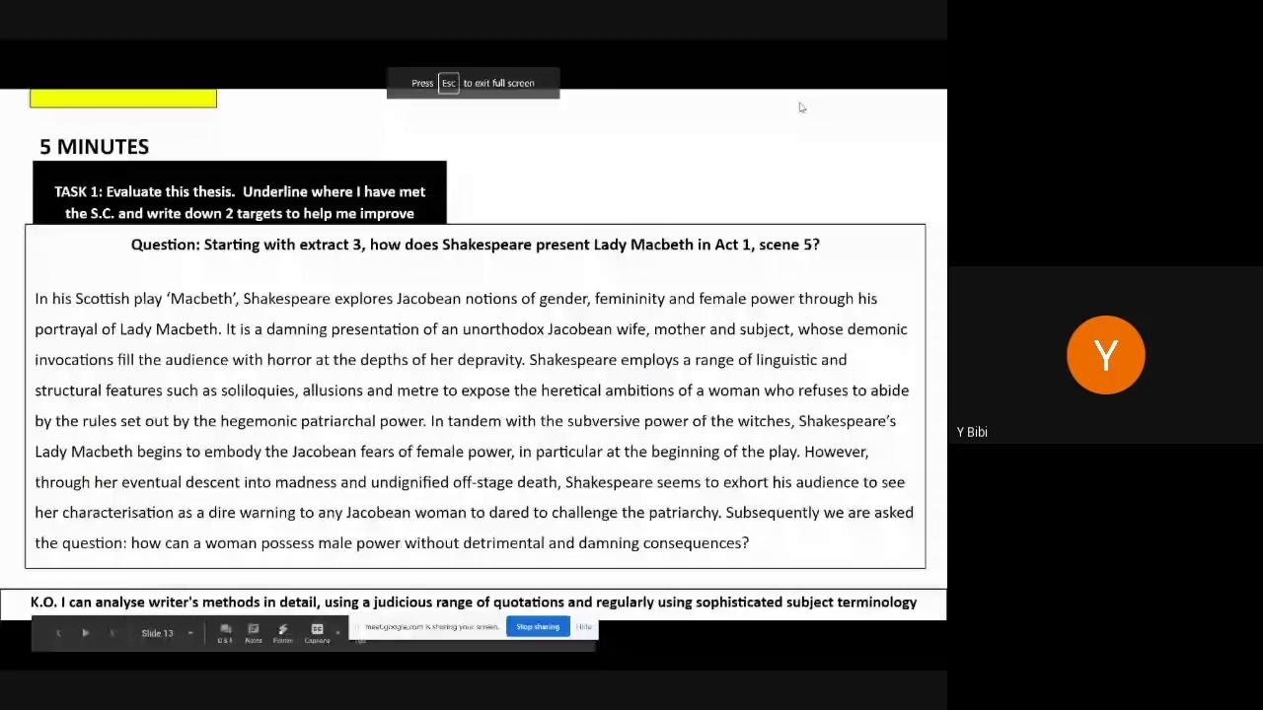
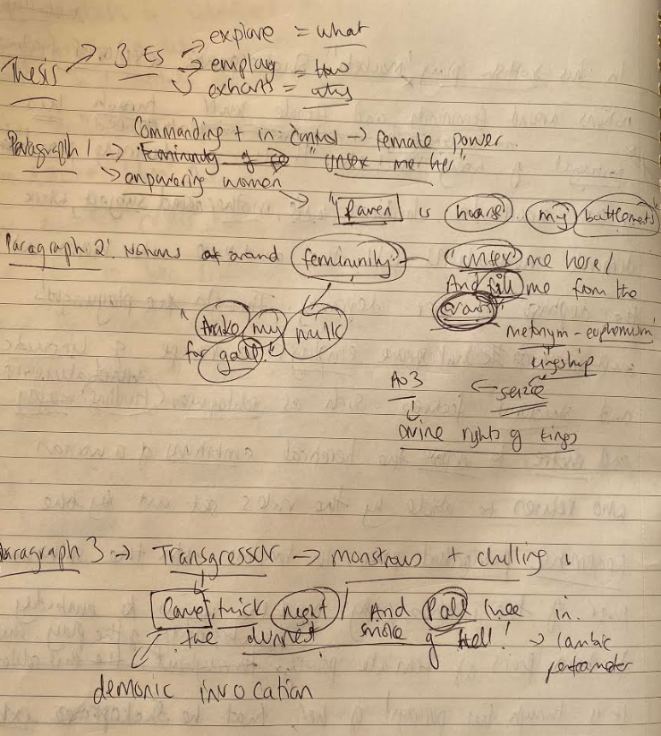
BE PROUD | AIM HIGH | WORK HARD | BE KIND | NO EXCUSES
Metacognition in Action
TASK: Watch the video below where I explain my thinking when I was constructing my thesis.
Here’s my (mad) planning before writing my thesis
K.O. I can analyse writer's methods in detail, using a judicious range of quotations and regularly using sophisticated subject terminology
Notes:
Watch a little section of the video. What am I doing in my explanation?
How is this Metacognition in Action?

Slide 11
Questioning What is it? How could you use it in your subject? | Hexagon Sentence Stems What is it? How could you use it in your subject? | Structured metacognitive work using grids What is it? How could you use it in your subject? | Reciprocal Reading What is it? How could you use it in your subject? | Metacognitive modelling What is it? How could you use it in your subject?
Exam Wrappers What is it? How could you use it in your subject? | Zones: comfort-challenge-panic What is it? How culd you use it in your subject? | Sliding Success Criteria What is it? How could you use it in your subject? | Providing feedback What is it? How could you use it in your subject? | Live feedback using target codes What is it? How could you use it in your subject?
TASK: You will have 5 minutes to explore each strategy. Discuss what makes each activity effective in developing students’ metacognitive thinking.
How could you use each strategy in your own lesson?
Notes:
15 mins- 3.35-3.50
First five to be explored in the session and then next five to be explored in mentor meetings/own time.
Teachers to complete during carousel activity.
Ask teachers to go through the strategies- only the first five and complete the grid.

Slide 12
BE PROUD | AIM HIGH | WORK HARD | BE KIND | NO EXCUSES
“All metacognition starts with questioning”
Knowledge | Comprehension- What is this task/event/ information about? What do I understand about it? What is it asking me to do? Connection- What do I already know about this? Have I seen anything like this before? What are the similarities and differences between this and other things in my past experiences?
Regulation | Strategy- Have I used this strategy before? Was it successful? Why? How can I ensure that I am successful this time? During the task- How is this going? What are my common errors in tasks like this? How can I avoid making those? What am i finding difficult right now? Why? What am I doing well? How do I know? Reflection after the task- Does my finished work look successful? Does it make sense? How do I know? Could I have approached this in a different way? Is this work an improvement on things I have done in the past? How?
Motivation | During the task- How do I feel about the work? Am I motivated to complete this task to a high standard? What can I do to improve my motivation right now? Reflection after the task- How did my motivation level affect my performance in that task? What emotions did I experience during the task? Why? How can I motivate myself in a different way in the future? Explain.
Jennifer Webb (2021) ‘The Metacognition Handbook’
Notes:
How do you train students to be metacognitive? It all starts with questioning.
Questioning is the most powerful tool we have in the classroom. We can pose questions to explore, to probe, to challenge, to push, to give feedback, to change direction, to test, to encourage. Our aim in metacognition is to train students to ask themselves a series of internal questions when they are working.

Slide 13
BE PROUD | AIM HIGH | WORK HARD | BE KIND | NO EXCUSES
Strategy: Metacognitive Modelling During Guided Practice
I do | We Do | You do
Start by explicitly modelling for students yourself. ‘I am doing this because…’ ‘I am selecting this word because…’ ‘I am looking for these elements because…’ Model your metacognitive process as the expert learner: ‘I know that I tend to….so I’m going to make sure that I..’ ‘Last time I forgot to...so I’m going to… ‘I’ve noticed that I’m missing...so I need to…’ ‘I’m noticing that this is drifting away from the question, so I need to...’ ‘I feel anxious about...so I’m trying to remind myself that…’ | Co-create work with students and use cold calling to invite contributions ‘What have we learned which would help us to start?’ ‘Can anyone give us an opening phrase?’ ‘Great, what is that an effective way to start?’ ‘How exactly should I phrase that?’ ‘Why did you choose X word instead of X word?’ ‘What are some of the common mistakes we might make when we are doing this?’ ‘What could we do while we write to avoid those mistakes?’ ‘What problem can you see with this line? What could we improve? Why is that more effective? | Students complete work independently using all the principles you have taught them. You can support students during the independent writing phase by doing the following things: Provide metacognitive prompts such as hexagon sentence stems. Ask students to write down three key things they need to remember based on their feedback from previous work. ‘Give students core content they might need (such as tier 2 and 3 vocabulary, definitions or dates)
Notes:
Model using a visualiser (ask Natascia for a visualiser in C04)
Model how to analyse a quotation explosion.
We do: Partially model as in the I do process but this time invite contributions from the students and prompt them to bringt their metacognitive knowledge and regulation into that activity with them
Activating prior knowledge
2. Explicit strategy instruction
3. Modelling of learned strategy
4. Memorisation of strategy
5. Guided practice
6. Independent practice
7. Structured reflection.

Slide 14
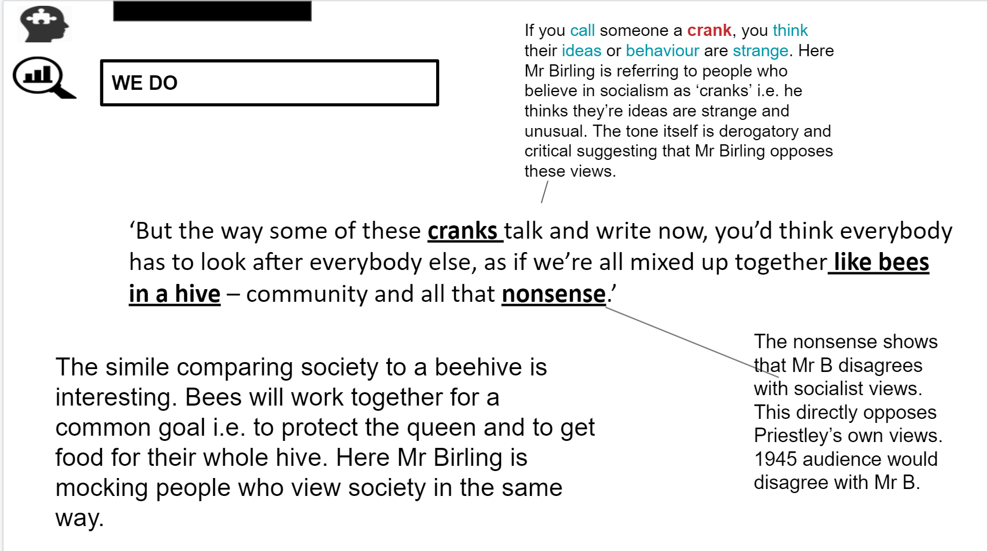
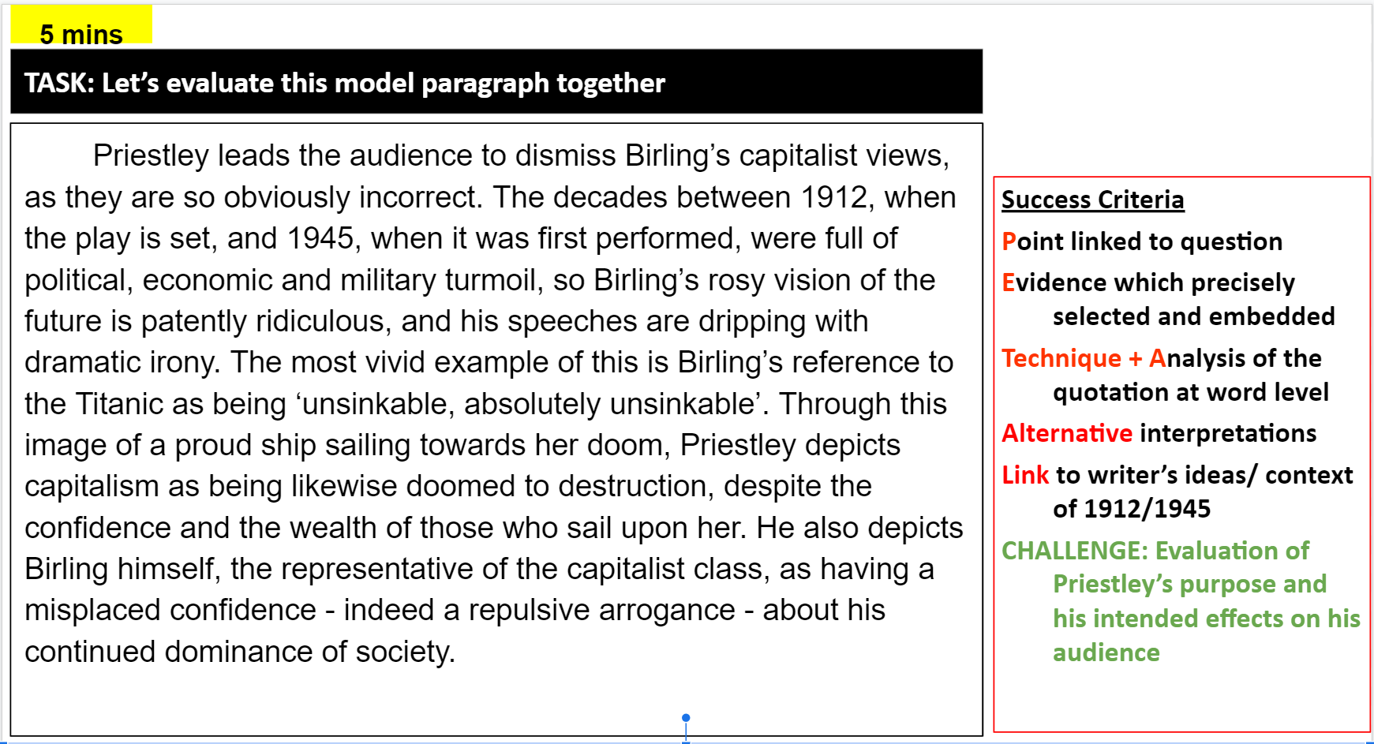
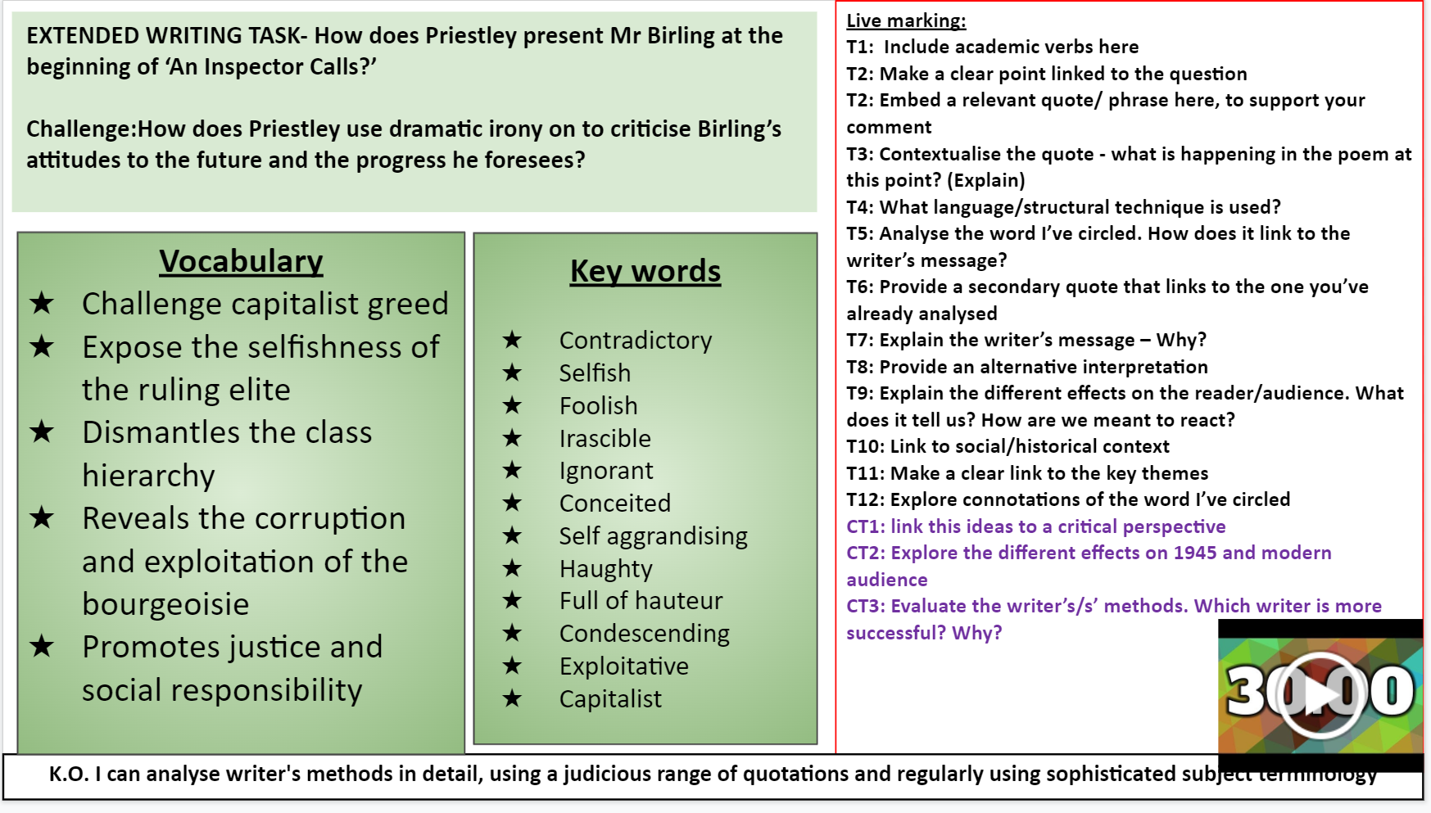
BE PROUD | AIM HIGH | WORK HARD | BE KIND | NO EXCUSES
Strategy: Metacognitive Modelling During Guided Practice

Slide 15
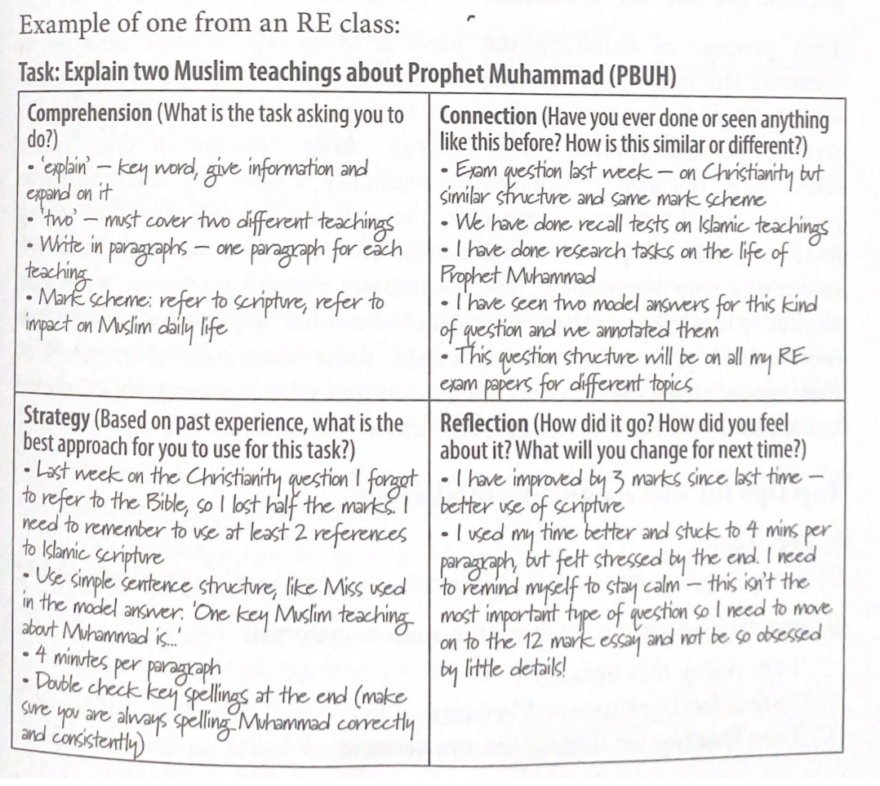
BE PROUD | AIM HIGH | WORK HARD | BE KIND | NO EXCUSES
Strategy: Helping students structure metacognitive work using grids
Comprehension (what is the task asking you to do?) | Connection (Have you ever done or seen anything like this before? How is this similar or different?)
Strategy (Based on past experiences, what is the best approach for you to use for this task?) | Reflection (How did it go? How did you feel about it? WHat will you change for next time?)

Slide 16
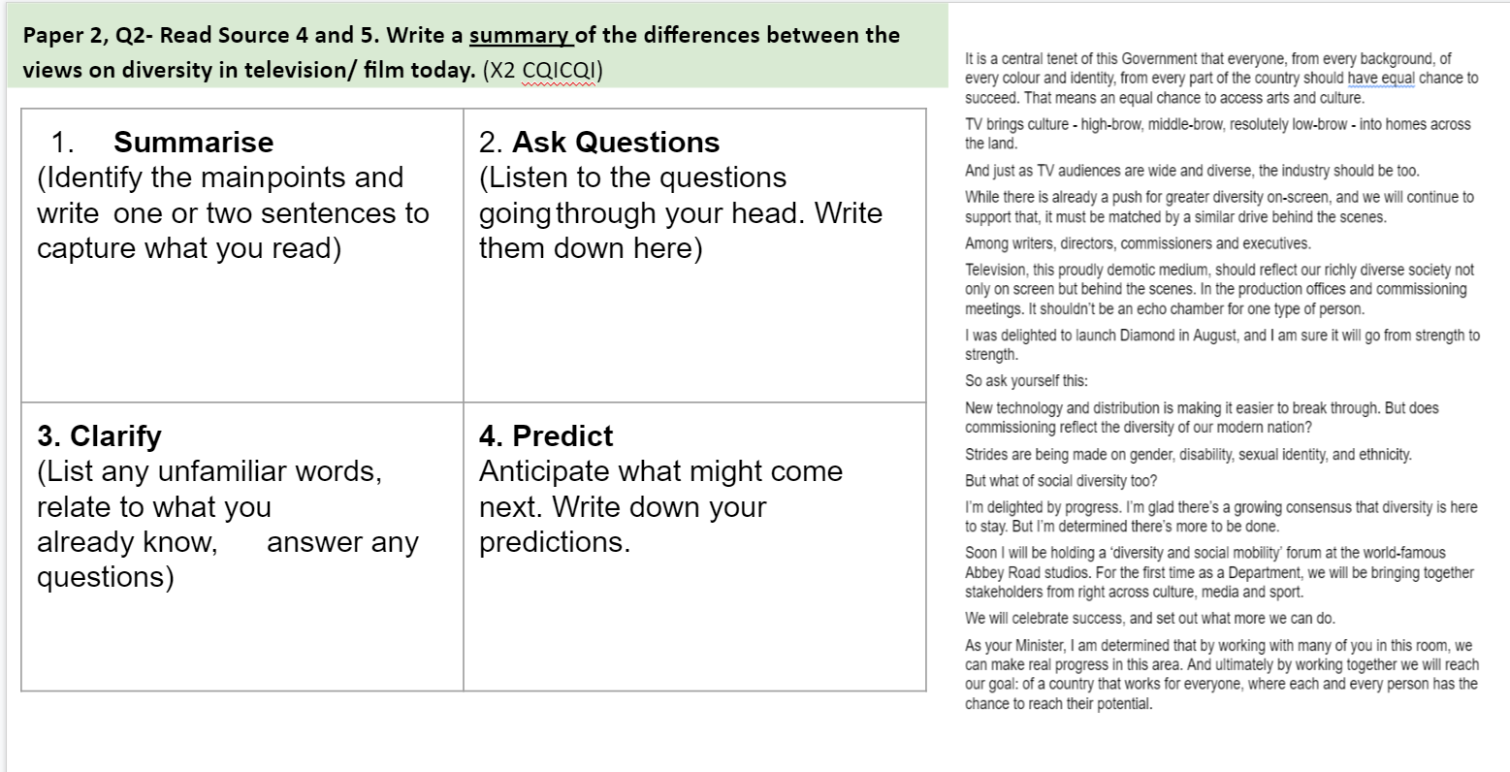
BE PROUD | AIM HIGH | WORK HARD | BE KIND | NO EXCUSES
Strategy: Using Reciprocal Reading to make the implicit explicit
Students are give this grid and allocated a different reciprocal reading role.
As students read a text, extract or chapter, students complete the grid.
Notes:
https://drive.google.com/file/d/1US_vAntOic04UQJkGNHxefKzIPbB_7xI/view?usp=sharing

Slide 17
BE PROUD | AIM HIGH | WORK HARD | BE KIND | NO EXCUSES
Strategy: Using Reciprocal Reading to make the implicit explicit
Predict I will think about what _______ is about. I will think about what we might read. I can: Use the title Use the subheading Use the topic sentences Use what I know already I will read the text to check my predictions. I will change my predictions as the author gives me more information. | Clarify I will write down words/phrases I do not understand. I will query concepts I’m unsure of. I can: Try another the word that makes sense or use a dictionary Use what I already know Make links to other concepts/ideas Read on or re-read passages I will offer clarification on key words and phrases. I will clarify meaning in the text so others understand. | Question I will ask questions to help me understand what I have read. I will think of questions while I am reading the text. I can: Formulate questions using the 5Ws and How Compare ideas and concepts Make links to other texts Gauge personal responses to a text I will examine key ideas and concepts. I will improve understanding of meaning. | Summarise I will identify the main ideas in the text. I will be concise. I can: Highlight key ideas and concepts Understand and explain meaning in paragraphs Rank the importance of ideas/feelings Explain the writer’s intentions I will explain the meaning of the text. I will condense significant ideas for all.
Notes:
Credit to Hana Malik!
These can be used as bookmarks

Slide 18
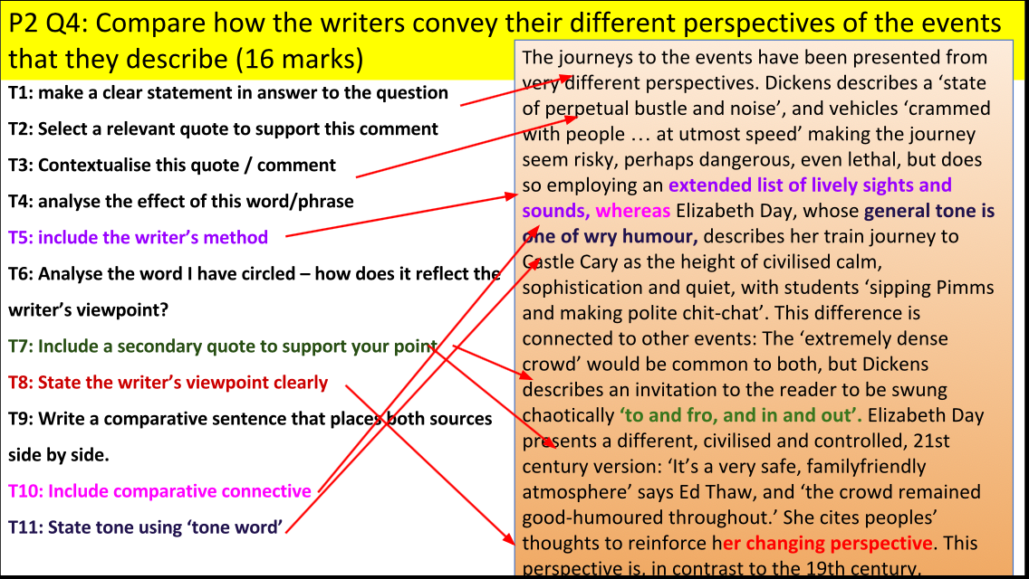
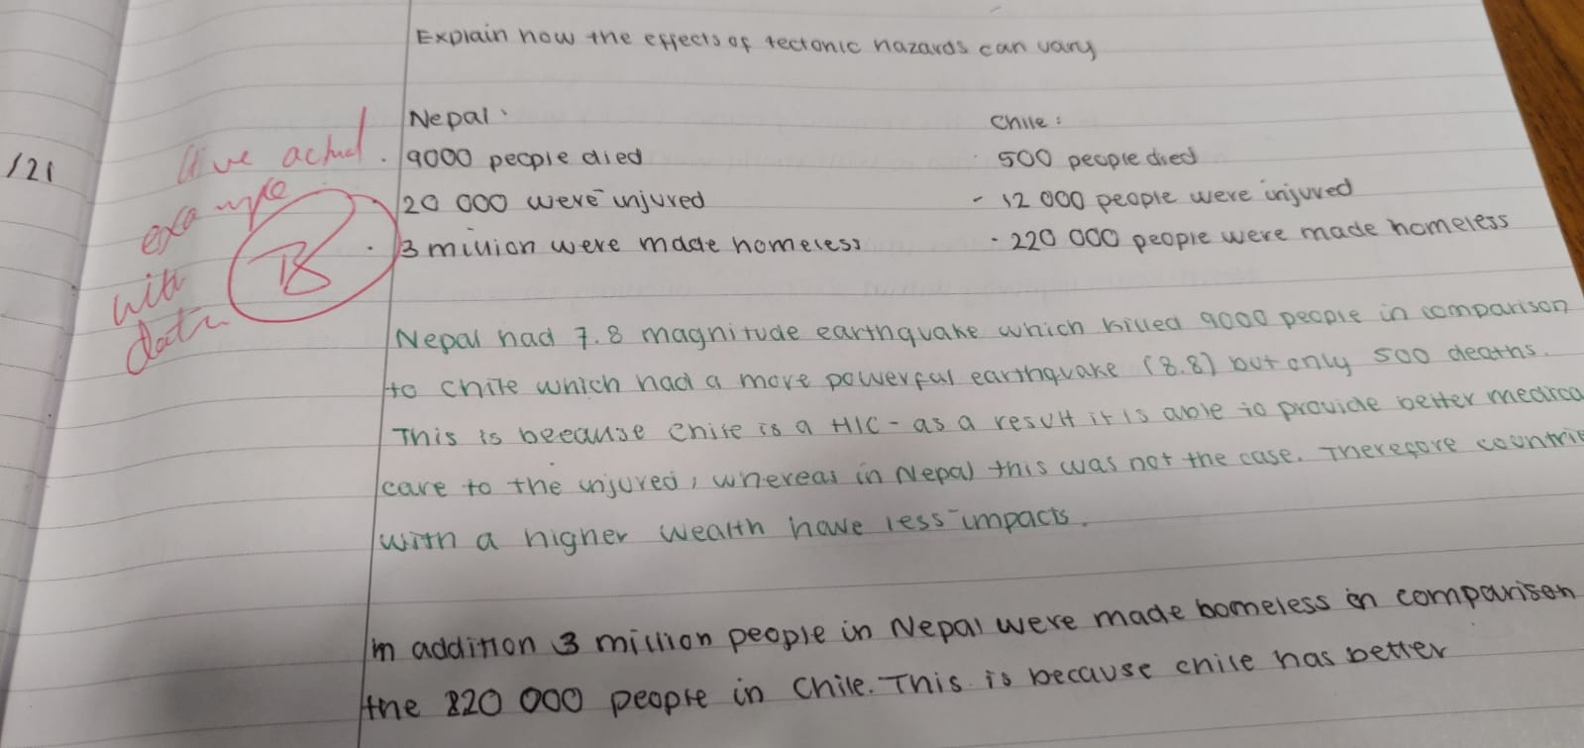
BE PROUD | AIM HIGH | WORK HARD | BE KIND | NO EXCUSES
Strategy: Live Feedback using Target Codes
While students working in silence, circulate the classroom giving students T-codes.
Students will then look at the board, copy down the target that matches the T Code and then apply feedback in green pen immediately.
Ross Morrison McGill (2017) ‘Mark. Plan. Teach.’
Notes:
As students write in silence, go around and live mark using t-codes.
Students
Green pen redrafting
Secondly, teachers can create opportunities for more detailed one to one verbal ‘feedback bites’ during the lesson. When circulating the room, you may notice that a pupil needs further direction to dispel misconceptions and put them back on the track to success.
You call that student over to your desk to provide this feedback. This allows you to spend time providing more in-depth feedback. During a lesson, you might use this option to give this feedback to a handful of pupils who need that further support to reach the learning intention.

Slide 19
BE PROUD | AIM HIGH | WORK HARD | BE KIND | NO EXCUSES
Strategy: Exam Wrappers
When did you start preparing for this assessment? (e.g. I have revised regularly all year; I didn’t prepare at all…) What did you do to prepare? Circle all that apply:
Self-quizzing | Create notes summaries | Completed online quizzes | Memorised key content
Studied with a friend or family member | Created flashcards from memory
Do you think this has been helpful? How?
How confident do you feel about this assessment? Why?
How motivated do you feel? How can you motivate yourself to do your best?

Slide 20
BE PROUD | AIM HIGH | WORK HARD | BE KIND | NO EXCUSES
Strategy: Exam Wrappers
What types of questions were the most challenging?
Type of question | Why did I find this challenging?
E.g. Drawing graphs
REGULATION: Next time I am going to do better by...
MOTIVATION: Next time I am going to motivate myself better by...
My teacher can help me in future by...
In this assessment I got… This is an improvement on/the same as/not as good as my last assessment because.. The biggest difference this time was...
Jennifer Webb (2021) ‘The Metacognition Handbook’
Notes:
A set of planning and reflection questions which students complete before and after an assessment.

Slide 21
BE PROUD | AIM HIGH | WORK HARD | BE KIND | NO EXCUSES
Strategy- Zones: comfort-challenge-panic
Process
Students are given the template below, plus a list of common activities or topics which you regularly set in lessons
Students then places these activities and topics into the appropriate circle
Teacher asks students to look at the items in the ‘comfort’ and ‘panic’ zones and annotate each one, explaining why they feel that way.
PANIC
CHALLENGE
COMFORT

Slide 22
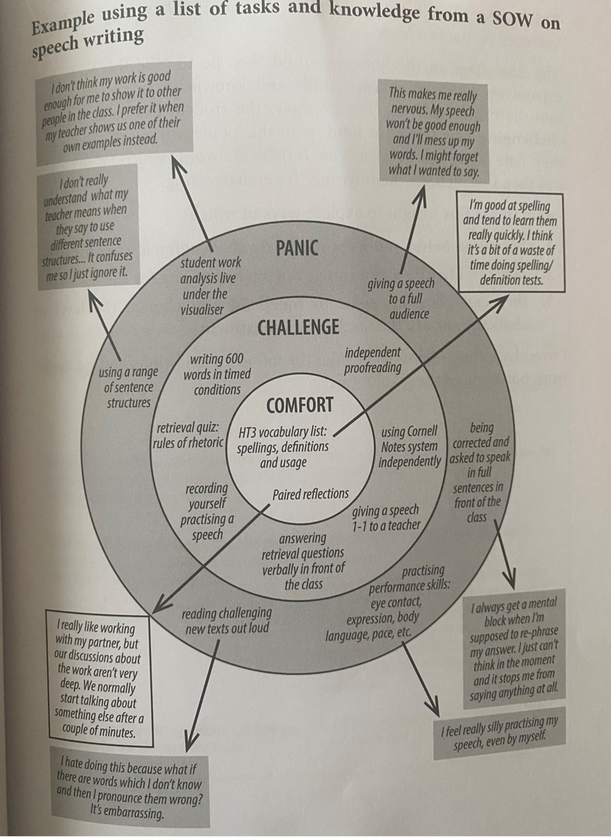
BE PROUD | AIM HIGH | WORK HARD | BE KIND | NO EXCUSES
Strategy- Zones: comfort-challenge-panic
Process
Students are given the template below, plus a list of common activities or topics which you regularly set in lessons
Students then places these activities and topics into the appropriate circle
Teacher asks students to look at the items in the ‘comfort’ and ‘panic’ zones and annotate each one, explaining why they feel that way.

Slide 23
BE PROUD | AIM HIGH | WORK HARD | BE KIND | NO EXCUSES
Strategy: Sliding Scale Success Criteria
Students shade in this column to show how well they think they will do on each area.
Success Criteria | Predict: How well will you do? | Regulate: On a scale of 1-10, how will you be successful? | Evaluate: After the task, how successful were you?
Teacher can pre-populate or students could create their own criteria using their metacognitive knowledge.

Slide 24
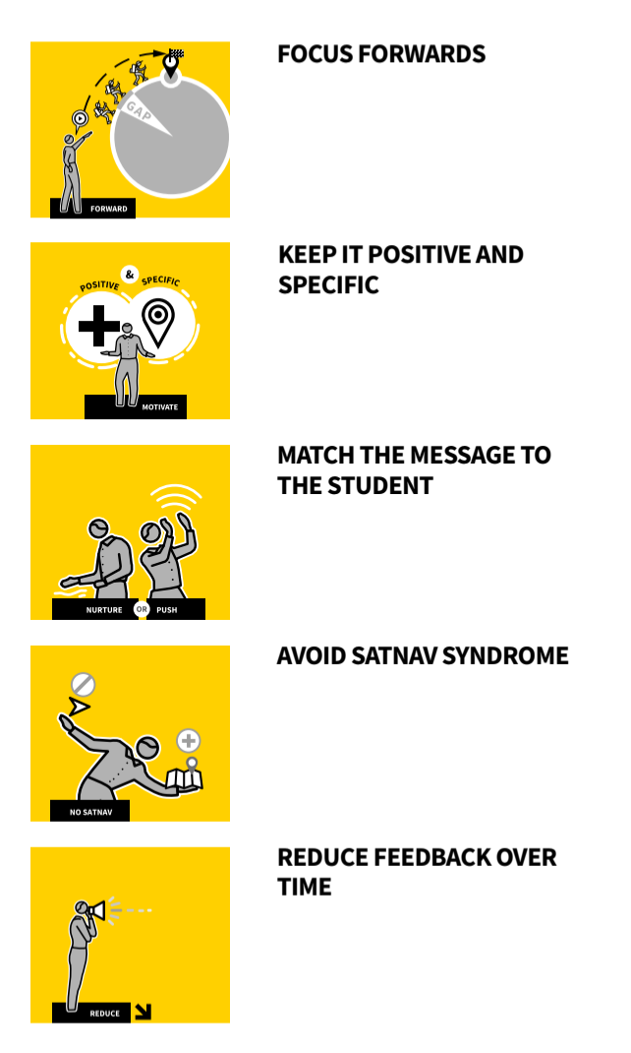
BE PROUD | AIM HIGH | WORK HARD | BE KIND | NO EXCUSES
Strategy: Providing feedback that motivates and moves learners forward
Identify areas of improvement.
Describe actions.
Give students the opportunity to make improvements
During not after
What Went Well...
Even Better If...
Be as specific as possible so that students receiving the feedback know what to do in response.
Learn how each student typically responds to feedback=relationship building
Trust it enough to use it and improve their performance.
Give your feedback focusing on changing students’ capacity to produce excellent work.
Give prompts and clues but leave students to take improvement steps independently, Make them think about what is needed, not simply following step by step instructions.
As students engage in Independent Practice and gain confidence, reduce the detail in the feedback given, allowing more struggle time before offering feedback.
Train students to generate as much self-assessed feedback using success criteria, exemplars of standards, study guides and worked answers as needed.”
Tom Sherrington and Oliver Caviglioli (2020). Teaching WalkThrus: Five-step guides for instructional coaching

Slide 25
BE PROUD | AIM HIGH | WORK HARD | BE KIND | NO EXCUSES
Strategy: using sentence stems to help students to learn metacognitively
I found…
difficult because...
Today I have learned about...
Next time I come across this, I will...
This will improve my work because...
I will build on this success in future by...
I found…
relatively easy because...
Beginner reflection after a task
Notes:
Beginner reflection after a task

Slide 26
BE PROUD | AIM HIGH | WORK HARD | BE KIND | NO EXCUSES
Strategy: using sentence stems to help students to learn metacognitively
I predict that I will do well on…because…
I am going to complete an assessment on…it will include…
I think I an going to struggle if…comes up, because…
Last time I did an assessment in history, I did…so I would like to improve by…
During the assessment, I need to remember to…
I am feeling motivated to do this assessment. I know it is important because…
Beginner pre-mortem before assessment
Notes:
Beginner reflection after a task

Slide 27
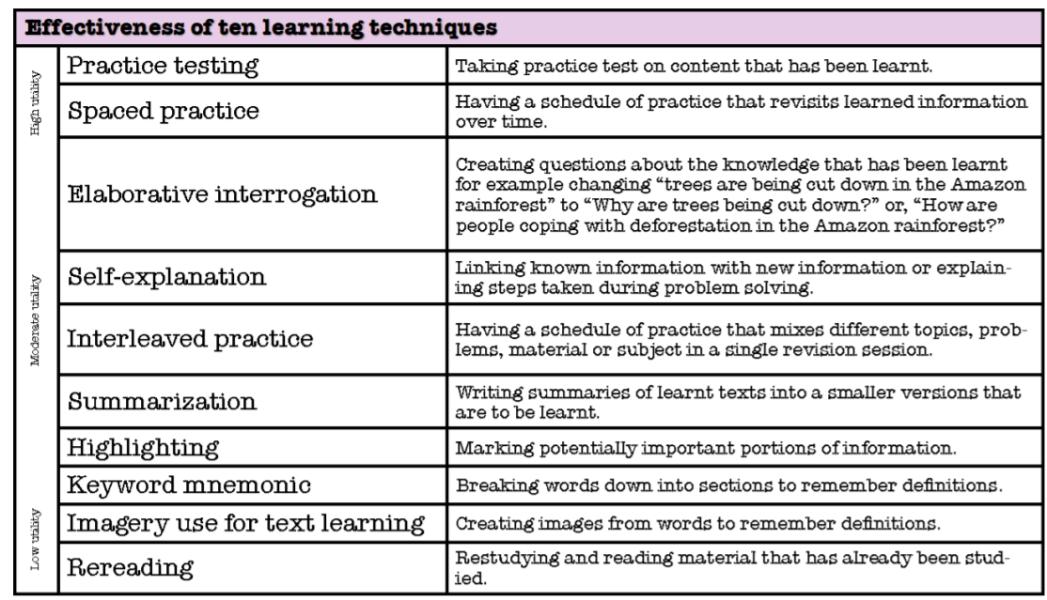
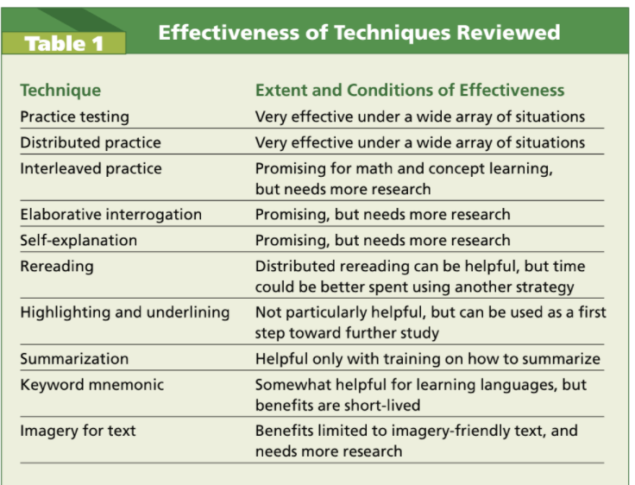
BE PROUD | AIM HIGH | WORK HARD | BE KIND | NO EXCUSES
Dunlosky’s Review of Learning Techniques
Notes:
Before you can teach students to learn metacognitively, students and teachers need to know the strategies that work

Slide 28
BE PROUD | AIM HIGH | WORK HARD | BE KIND | NO EXCUSES
GOAL SETTING
Session takeaways:
To understand the importance and role of metacognition in supporting learners
To learn more about the EEF’s plan, monitor, evaluate model
To learn more about Michalsky’s metacognitive model
To identify and evaluate strategies to explicitly teach students how to learn metacognitively
My goal
Use the questions as prompts to set an effective goal for yourself.
What is your goal?
When will you do this? (set a date)
Which class will you do this with?
______________________________________________________________________________________________________________________________________________________________________________________________________________________________________________________________________________
On a scale of 1-10, how likely are you to achieve this goal?
BE PROUD | AIM HIGH | WORK HARD | BE KIND | NO EXCUSES
Notes:
3.50-3.55pm-set a goal for yourself
3.55-4.00pm-which ones will you use? How will yoy use it in your next lesson?

Slide 29
BE PROUD | AIM HIGH | WORK HARD | BE KIND | NO EXCUSES
REVIEWING LEARNING
List the 5 step approach to introducing new knowledge
(hint: Rosenshine’s Principles)
What is the working and long term memory?
Explain the forgetting curve and why it is important.
What does the term metacognition mean according to the EEF?
Name two strategies from today’s session.
Notes:
3 mins as a do now

Slide 30
BE PROUD | AIM HIGH | WORK HARD | BE KIND | NO EXCUSES
Want to know more?
Alex Quigley et al Metacognition and Self Regulated Learning, EEF
Tova Michalsky (2013) Integrating Skills and Wills Instruction in Self-Regulated Science Text Reading for Secondary Students
Elizabeth MountStevens (2020) Modelling and metacognition in a secondary classroom
https://earlycareer.chartered.college/modelling-and-metacognition-in-a-secondary-classroom/
Jenny Webb (2021) The Metacognition Handbook
https://blog.innerdrive.co.uk/9-questions-to-improve-metacognition
@msybibi
BE PROUD | AIM HIGH | WORK HARD | BE KIND | NO EXCUSES
Notes:
Print this for each person

