Slide 1
Amazing TAs! How to get the best out of having a Teaching Assistant

Slide 2
Prayer –

Slide 3
Questionnaire – 5 minutes

Slide 4
The Aim of TAs
In your break out rooms discuss the ‘aim of TA’s’ and ‘The TA Role’
Create a sentence that describes the aim of a TA and a list of ways in which they can achieve this!
Consider - Why do they exist? What is the desired outcome? Who are they there for? What is their purpose?
Have a spokesperson to feedback in the main room.

Slide 5
Feedback from each group

Slide 6
The Aim of TAs
“No matter what level of ability, regardless of whether the child is gifted or talented, has SEN needs or a disability, or is working at aged-related expectations, the effective teaching assistant’s overarching aim is to enable a pupil to move from needing assistance to being able to work independently.”

Slide 7
The TA Role…
Their role is to help “Raise standards” by:
Support for the pupil.
Support for the teacher.
Support for the curriculum.
Support for the school.
Support staff can help to:
Raise the performance of individual pupils
Provide coping strategies for pupils
Assist in management of pupils behaviour
Promote pupils’ independence
Support the development of differentiated curricular approaches to meet the diversity of pupils’ learning needs

Slide 8
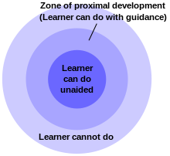
Some Science: Vygotsky’s theory! Particularly true with SEN
Vygotsky (1896 -1934)describes the area between a child’s level of independent performance and what they can only do with support is the ‘Zone of Proximal Development’ (ZPD)
We should always aim to work within a child’s ZPD as in the diagram
If you work within the area that the learner cannot do the child will become frustrated, confused and disaffected with learning. Behaviour issues may become an issue.

Slide 9
Teachers/TAs as Class Teams
In your breakout rooms, discuss ‘How can we as teachers work with TAs to carry out their role effectively?’
Make a list and be ready to feedback one of them to the whole group.

Slide 10
Feedback from each group

Slide 11
Teachers/TAs as Class Teams
To use a Teaching Assistant effectively they must benefit all the pupils in your class, not only at the top or bottom but across the spectrum! (No student should have a TA superglued to them, unless absolutely specified by an EHCP, even then – teaching independence should be an intrinsic part of their daily learning).
Support staff can do much to help to promote the inclusion of students into their school.
A TA who is briefed as to what is planned for a lesson, is in a stronger position to help the teacher realise his/her aims. (This is fine at the beginning of lesson, whilst pupils complete a starter, sharing PP, etc)**TAs do not have planning time
As a member of a team, the assistant is in a good position to observe pupil performance and to provide the teacher with valuable thoughts on what works for pupils and what obstacles to learning they encounter.

Slide 12
In-class support staff should work in partnership with teaching staff; the classroom teacher acts as senior colleague and subject specialist, with the in-class support staff acting as assistant to the teacher and specialist in additional needs. Teaching staff must plan which students and what activities the TA should focus on for each session. ** the job of the TA is not to prepare additional resources for students or photocopy for staff.
In your planning, the TA should be identified in every stage of the lesson, and it should be clear where he/she would be most beneficial during starter activity, main delivery, independent working and the plenary. ** This is the teachers planning!! Tas do not have planning time to joint plan. (work with ………. Is not clear direction, you need to be explicit)

Slide 13
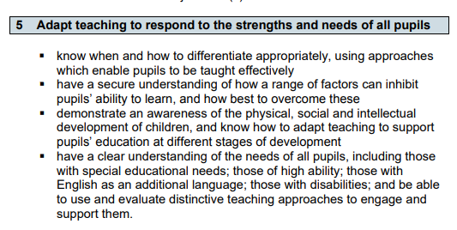

Slide 14
Education Endowment Foundation https://educationendowmentfoundation.org.uk/education-evidence/guidance-reports/send
‘Research that examines the impact of TAs providing general classroom support suggests that students in a class with a teaching assistant present do not, on average, outperform those in one where only a teacher is present. This average finding covers a range of impacts. In some cases teachers and TAs work together effectively, leading to increases in attainment. In other cases pupils, particularly those who are low attaining or identified as having special educational needs, can perform worse in classes with teaching assistants.’

Slide 15
EEF Recommendations
TAs should not be used as an informal teaching resource for low-attaining pupils
Use TAs to add value to what teachers do, not replace them
Use TAs to help pupils develop independent learning skills and manage their own learning
Ensure TAs are fully prepared for their role in the classroom *Training * a shared PP or quick chat at beginning of lesson is fine for sharing plans!
Use TAs to deliver high-quality one-to-one and small group support using structured interventions
Adopt evidence-based interventions to support TAs in their small group and one-to-one instruction
Ensure explicit connections are made between learning from everyday classroom teaching and structured interventions

Slide 16
Session 2 – How TAs can support learning
Scaffolding
Relaying
Zoning
Coaching
Facilitating
Supervising
Safeguarding

Slide 17
Any Questions -

